Slide 1


Formation R-Shiny
https://tinyurl.com/ifb-shiny19-gslides
Institut Pasteur, Paris, les 12 et 13 septembre 2019
Formateurs : C. Malabat, C. Midoux
Organisateurs : H. Chiapello, Y. Mahmah
Avec du matériel pédagogique de Frédéric Schütz (SIB)
Notes:
Partenariat IFB-SIB et implication des plateformes Hub de Bioinfo et Biostat (I. Pasteur Paris) et Migale (Inra Jouy-en-Josas).
Gros succès 40 inscrits pour 15 places. Deuxième session le 13 septembre lancée et peut-être une troisième ensuite. Présentation des organisateurs.

Slide 2
Programme
Première journée : 9:30-17:30
09:30 - 09:45 Accueil et tour de table
09:45 - 10:45 Introduction
10:45 - 11:00 Pause
11:00 - 13:00 Ma première appli Shiny
13:00 - 14:00 Déjeuner
14:00 - 15:15 Exercices (session 1)
15:15 - 15:30 Pause
15:30 - 17:30 Exercices (session 2)
Deuxième journée : 8:30-16:30
09:30 - 10:30 Retour sur la 1ère journée, bilan des exercices
10:30 - 10:45 Pause
10:45 - 12:00 Déploiement d’application Shiny (cours et exercice pratique)
12:00 - 13:00 Déjeuner
13:00 - 15:00 BYOS (BringYourOwnScript) - adaptation de script personnel en interface shiny(session 1)
15:00 - 15:15 Pause
15:15 - 16:00 BYOS (BringYourOwnScript) - (session 2)
16:00 - 16:15 Bilan 2ème journée et conclusion du cours.
Notes:
Format original : on se forme durant la première journée et on apprend ensuite à former les autres durant la deuxièmes journée

Slide 3
Tour de table
Vous ? Votre équipe / unité ?
Votre première expérience de Shiny ?
Vos attentes ?

Slide 4
Liens utiles
GitHub du cours : https://github.com/IFB-ElixirFr/IFB_Shiny_training
Shiny gallery: https://shiny.rstudio.com/gallery/
Shiny gallery widget: https://shiny.rstudio.com/gallery/widget-gallery.html
Lien CheatSheet : https://shiny.rstudio.com/images/shiny-cheatsheet.pdf
Lien CheatSheet VF : https://thinkr.fr/pdf/shiny-french-cheatsheet.pdf

Slide 5
General introduction to R Shiny

Slide 6
Data analysis workflow
Program
R
Understand
Visualize
Prepare
Import
Tidy
Transform
Communicate
Model
Adapted from Hadley Wickham
"R for data analysis"

Slide 7
Data analysis workflow
Program
R
Understand
Visualize
Prepare
Import
Tidy
Transform
Communicate
Model
Adapted from Hadley Wickham
"R for data analysis"

Slide 8
Introduction à R Shiny
How do you share R results with your collaborators ?

Slide 9
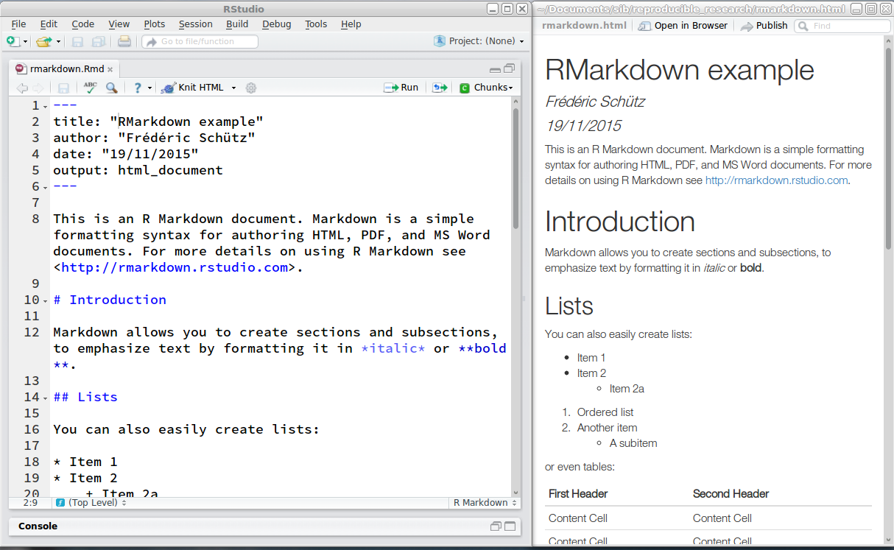
Share my R code and results

Slide 10
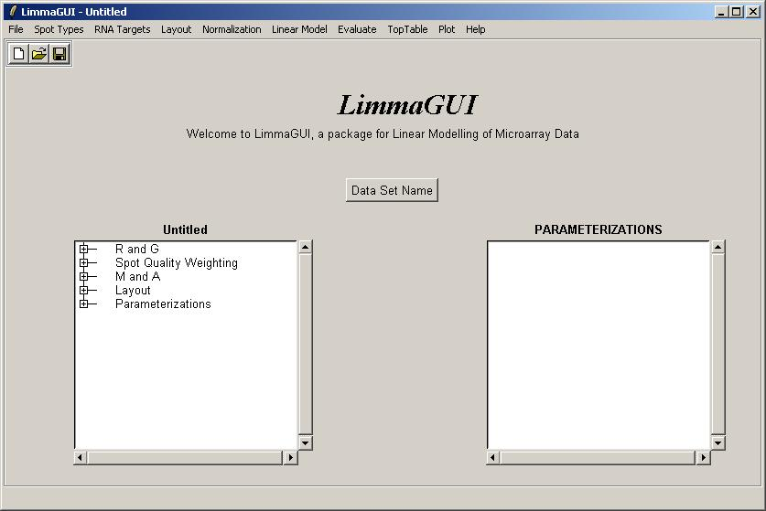
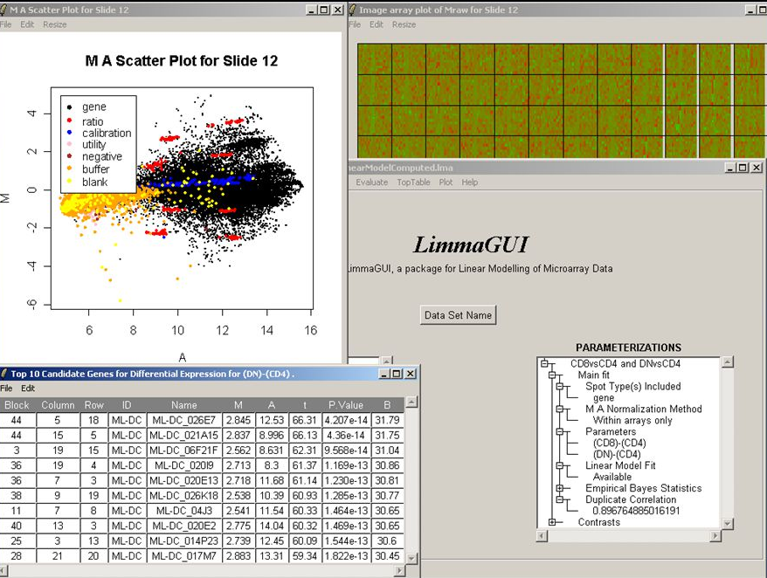
Share my R code and results

Slide 11
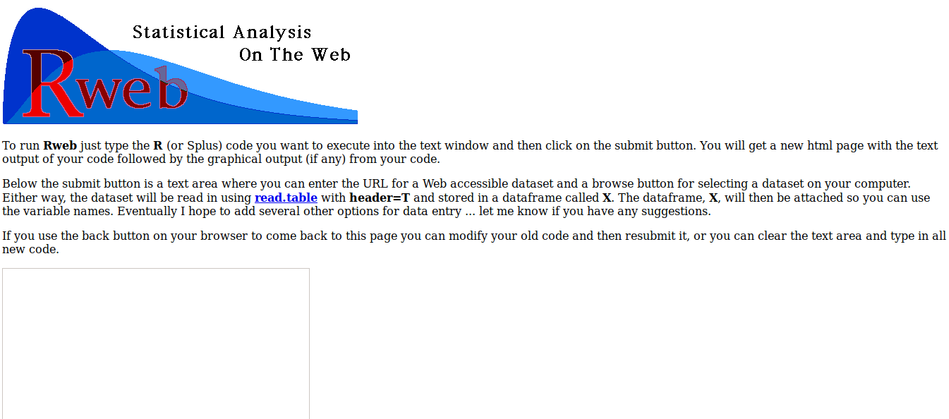
Share my R code and results

Slide 12
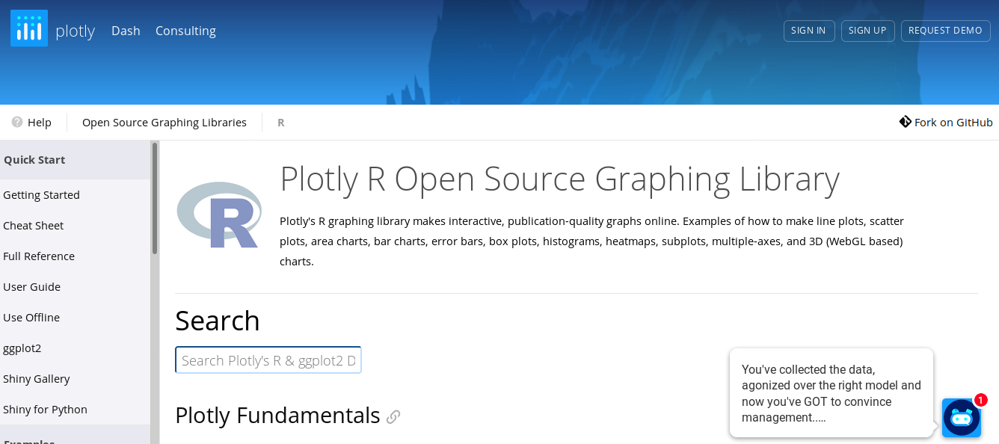
Share my R code and results

Slide 13
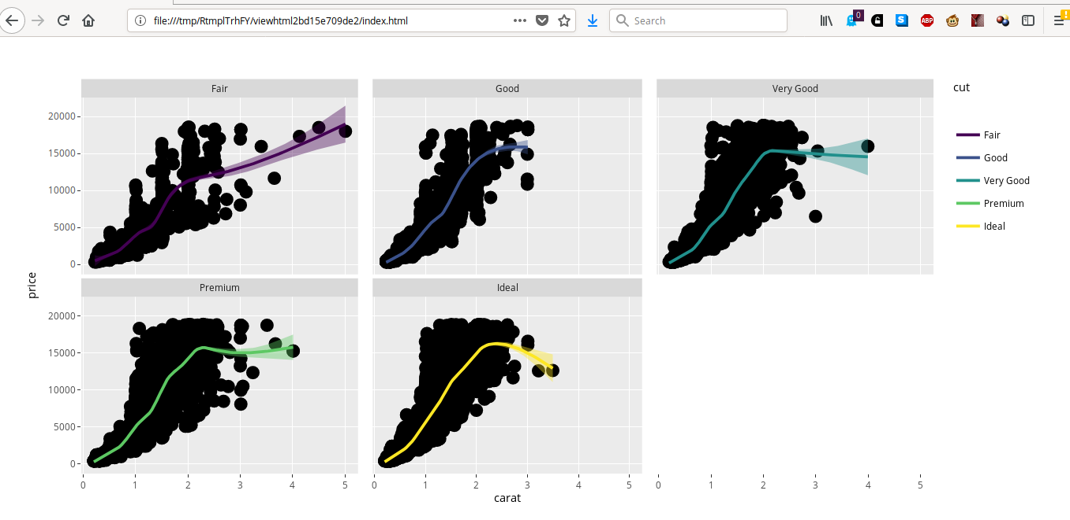
Share my R code and results
https://plot.ly/ggplot2/getting-started/

Slide 14
Data analysis workflow
Program
R
Understand
Visualize
Prepare
Import
Tidy
Transform
Communicate
Model
Adapted from Hadley Wickham
"R for data analysis"

Slide 15
General introduction to R Shiny
"Interactive" analysis with R (and Rstudio): accessing an R application

Slide 16
Rstudio code for histogram plot
x <- faithful$waiting
# number of bins = 10
nbins <- 10
hist(x, breaks = nbins, col = "#75AADB",
border = "white",
xlab = "Waiting time to next eruption (in mins)",
main = "Histogram of waiting times")
# number of bins = 50
nbins <- 50
hist(x, breaks = nbins, col = "#75AADB",
border = "white",
xlab = "Waiting time to next eruption (in mins)",
main = "Histogram of waiting times")

Slide 17
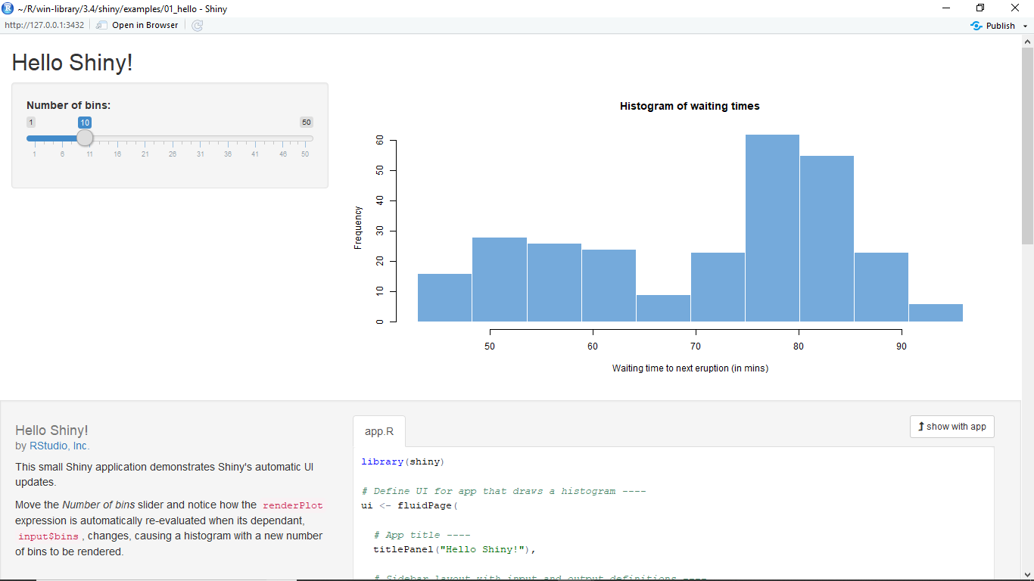
Shiny application for histogram interactive plot

Slide 18
Shiny application for histogram interactive plot
shiny::runExample("01_hello")

Slide 19
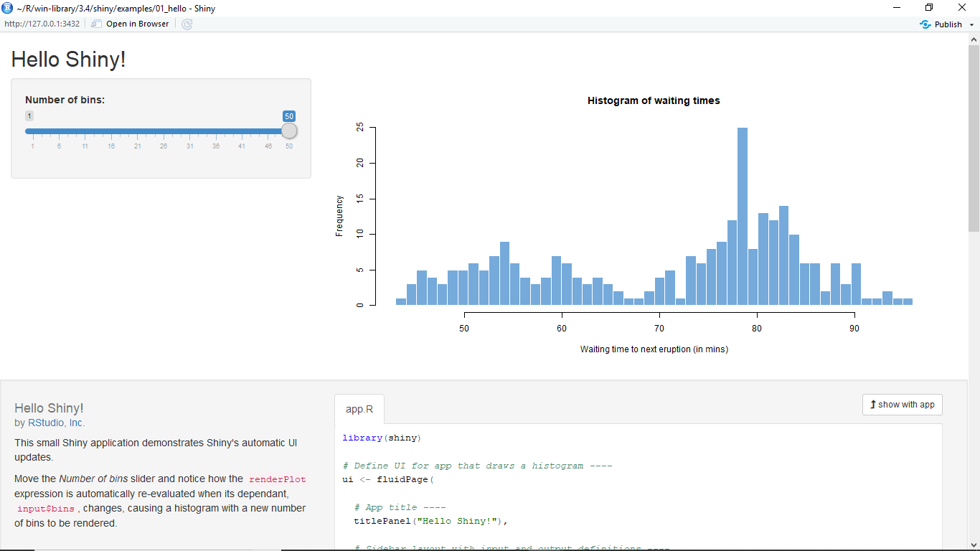
Shiny application for histogram interactive plot
shiny::runExample("01_hello")

Slide 20
Introduction à R Shiny
How can I access R results through a web client ?

Slide 21
Web browser
Web page
Client
Local filesystem

Slide 22
Web browser
Web server
Client
Server

Slide 23
Web browser
Web server
R
Client
Server

Slide 24
Web browser
Web server
R
Client
Server
Notes:
Pourquoi 2 fois R ?

Slide 25
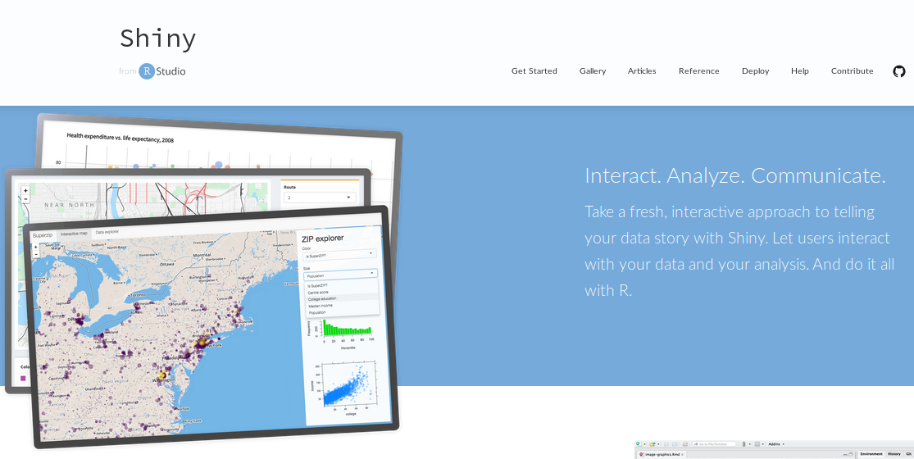
https://shiny.rstudio.com/

Slide 26
Web page
Web browser
Web server
R
Web
framework
R
Client
Server
Notes:
Pourquoi 2 fois R ?

Slide 27
Web browser
Shiny
Client
Server

Slide 28
R Shiny - RStudio
“Shiny is an R package that makes it easy to build interactive web apps straight from R.
You can host standalone apps on a webpage or embed them in R Markdown documents or build dashboards.
You can also extend your Shiny apps with CSS themes, htmlwidgets, and JavaScript actions.”

Slide 29
Shiny advantages
For R developers
Easy distribution via only a web address
Save time, focus on advanced questions
Make work valorisation and code publication easier
Reproducibility
For users
no line command
no install R/library
no update, package issues
Become autonomous for personal data exploration/analysis

Slide 30
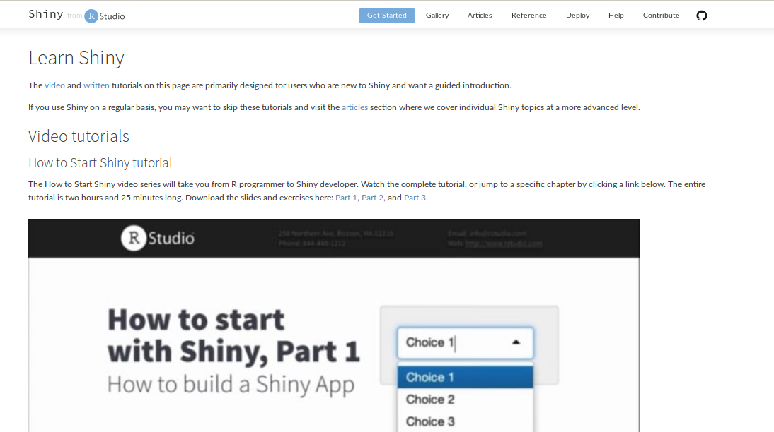
Documentation on Shiny
https://shiny.rstudio.com/tutorial/

Slide 31
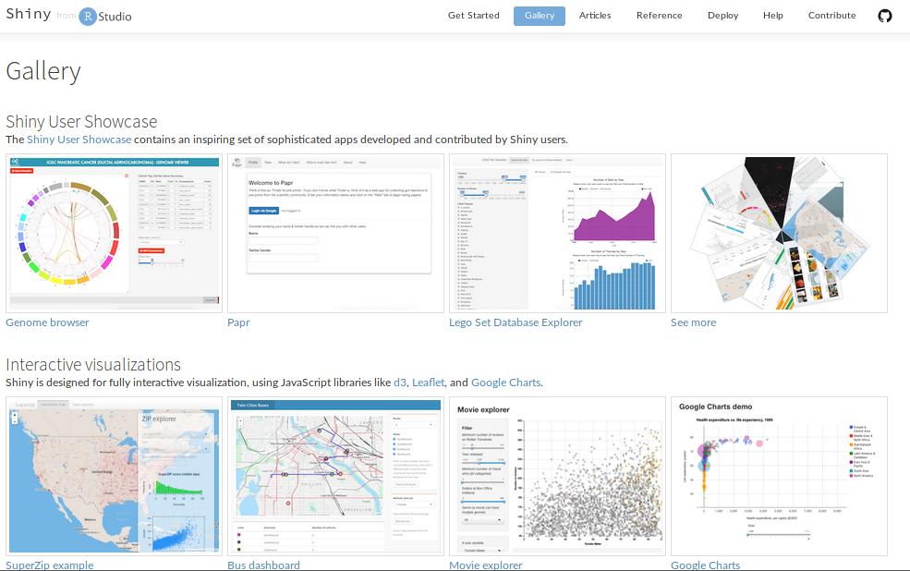
Examples of Shiny apps
https://shiny.rstudio.com/gallery/

Slide 32
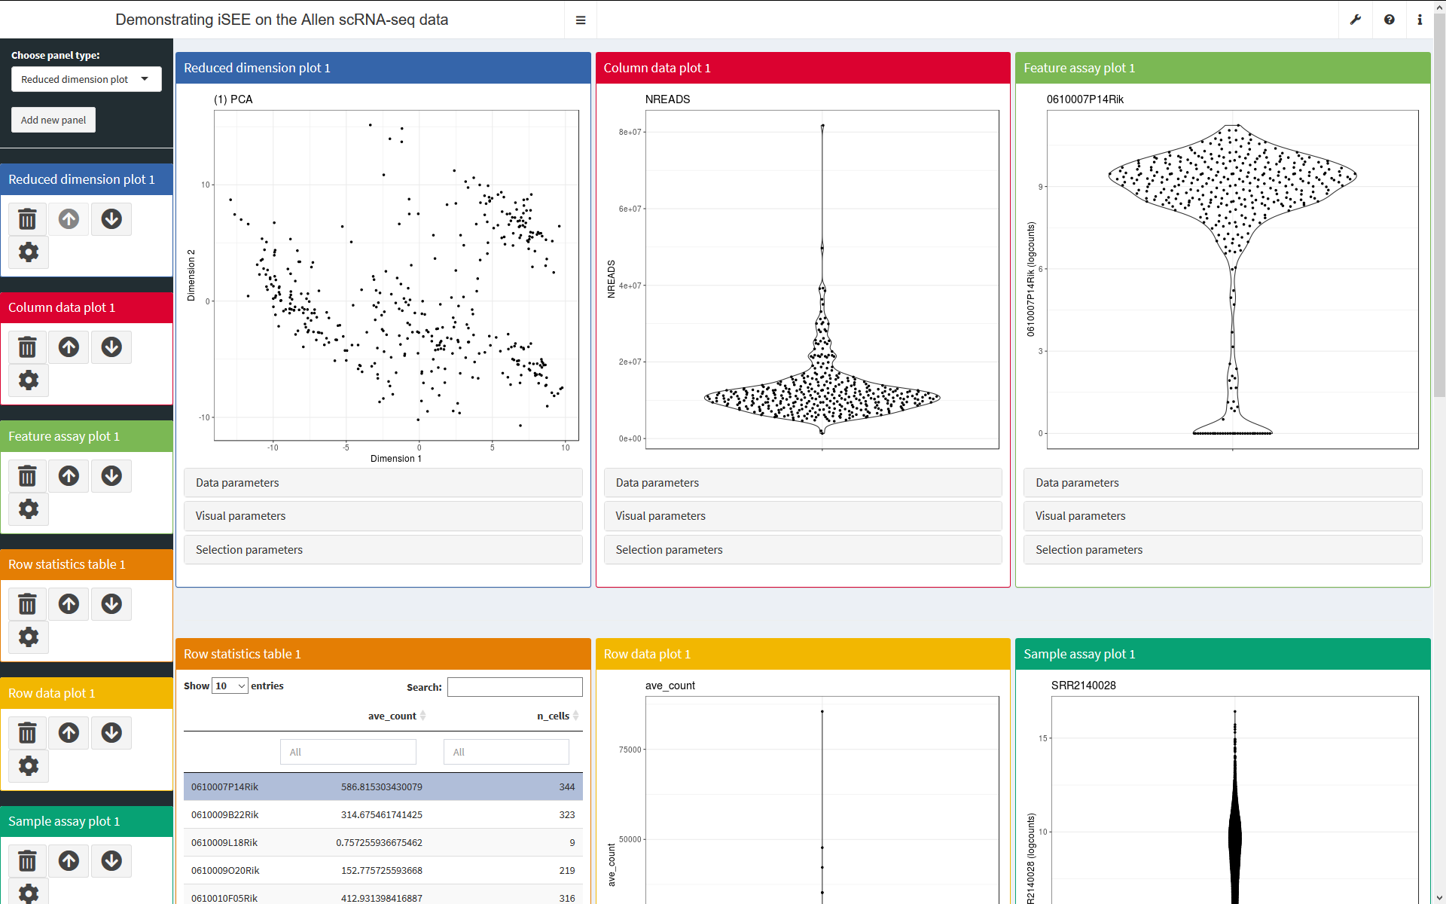
Example of Shiny applications – iSEE
https://marionilab.cruk.cam.ac.uk/iSEE_allen/

Slide 33
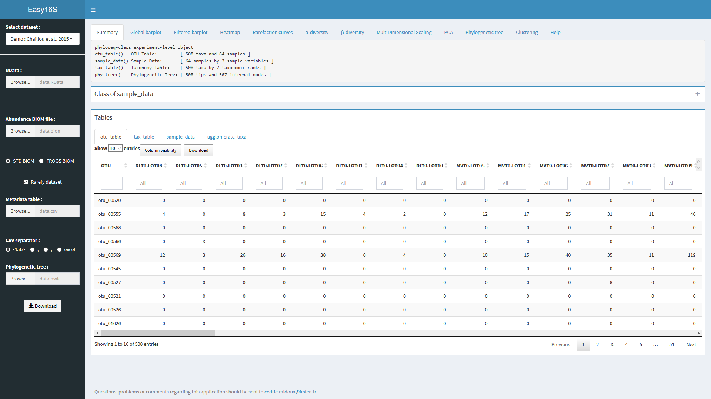
Example of Shiny applications – Easy16S
http://genome.jouy.inra.fr/shiny/easy16S/

Slide 34
How to start with Shiny ?
> install.packages("shiny")
> library(shiny)

Slide 35

How to start with Shiny ?
> install.packages("shiny")
> library(shiny)

Slide 36
How to start with Shiny ? – runExample()
runExample("01_hello") # a histogram
runExample("02_text") # tables and data frames
runExample("03_reactivity") # a reactive expression
runExample("04_mpg") # global variables
runExample("05_sliders") # slider bars
runExample("06_tabsets") # tabbed panels
runExample("07_widgets") # help text and submit buttons
runExample("08_html") # Shiny app built from HTML
runExample("09_upload") # file upload wizard
runExample("10_download") # file download wizard
runExample("11_timer") # an automated timer
→ pick up one example and run it on your Rstudio

Slide 37
My first Shiny app

Slide 38
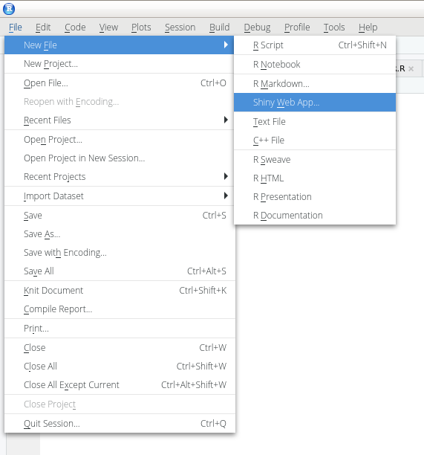
Shiny in RStudio – Creating my first Shiny app

Slide 39
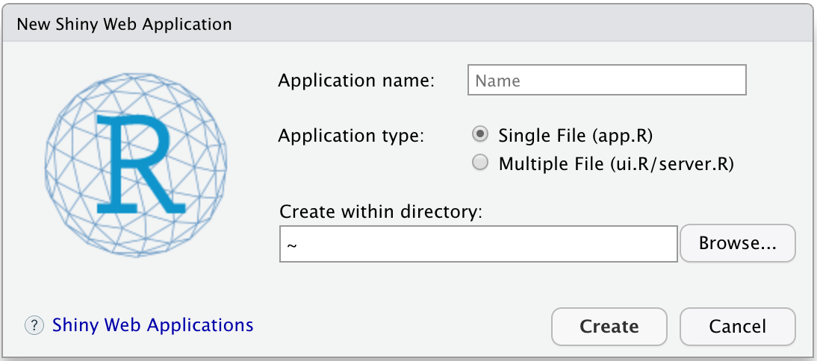
Shiny in RStudio – Creating my first Shiny app

Slide 40
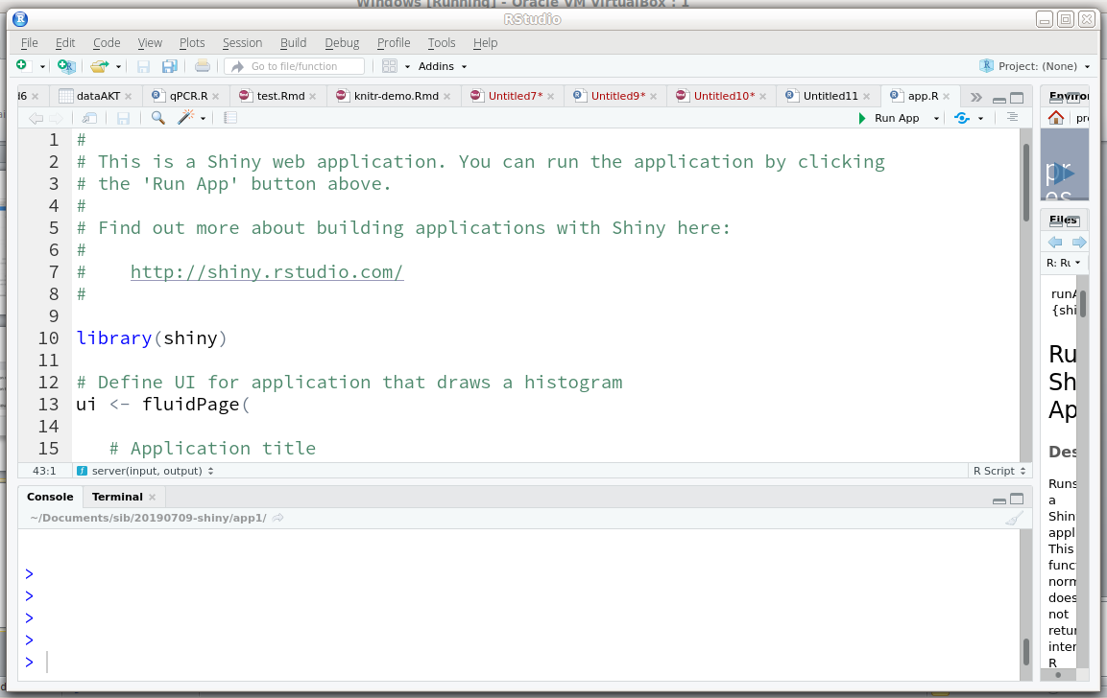
Shiny in RStudio – Creating my first Shiny app

Slide 41
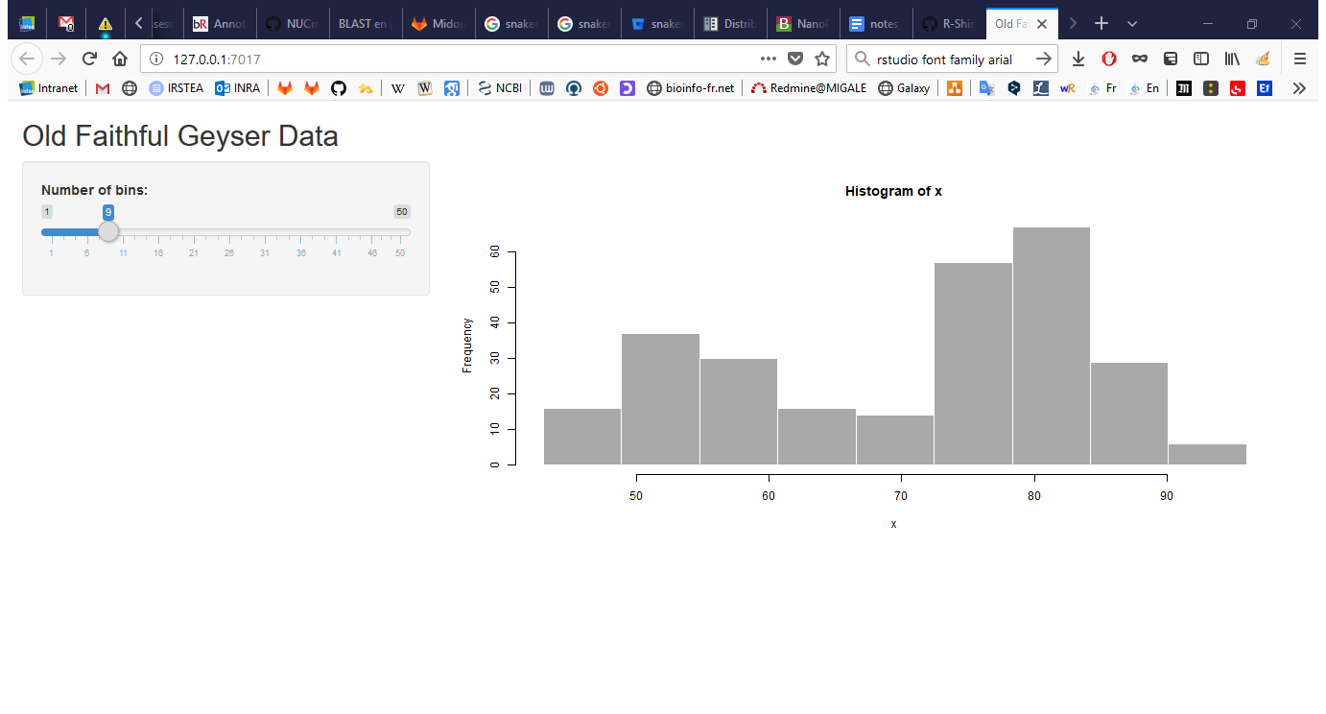
Shiny in RStudio – Creating my first Shiny app

Slide 42
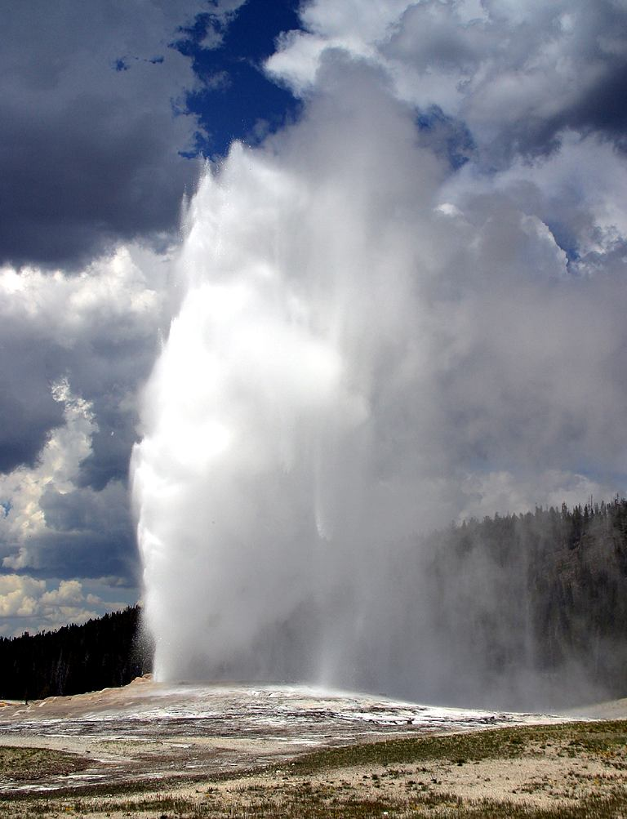

Shiny in RStudio – Creating my first Shiny app
Old Faithful
Yellowstone

Slide 43
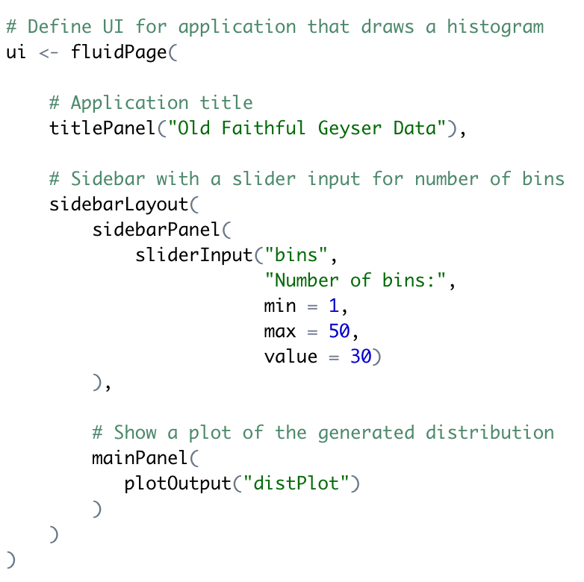
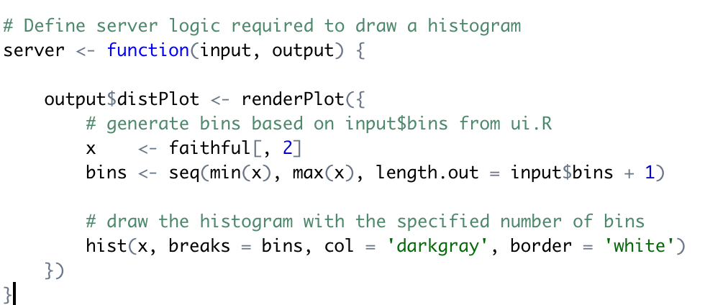
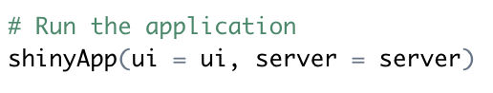
Anatomy of a Shiny app

Slide 44
Anatomy of a Shiny app
A simple Shiny app consists of two components:
ui (user interface) creates the layout of the application and the user controls
server creates the content based on the user’s selections

Slide 45
Anatomy of a Shiny app
One single file app.R (recommended)
ui <- fluidPage(
)
server <- function(input, output) {
}
shinyApp(ui = ui, server = server)

Slide 46
Anatomy of a Shiny app
Two files in the same folder
ui.R
server.R
shinyUI(fluidPage(
)
)
shinyServer(function(input, output) {
})

Slide 47
Anatomy of a Shiny app : data flow
ui
Input widgets
server
Collect
parameters
Load packages
Load data
Output functions
Conduct analysis – generate tables and graphs
Send rendered objects back to UI

Slide 48
How do the ui and the server communicate ?
ui
server
*Input(inputId = « in1 »,
label = « »),
*Output(outputId = « out1 »)
output$out1 < - render*(input$in1)

Slide 49

My first Shiny app
My first (non trivial) Shiny app: generating random number and plotting and histogram

Slide 50
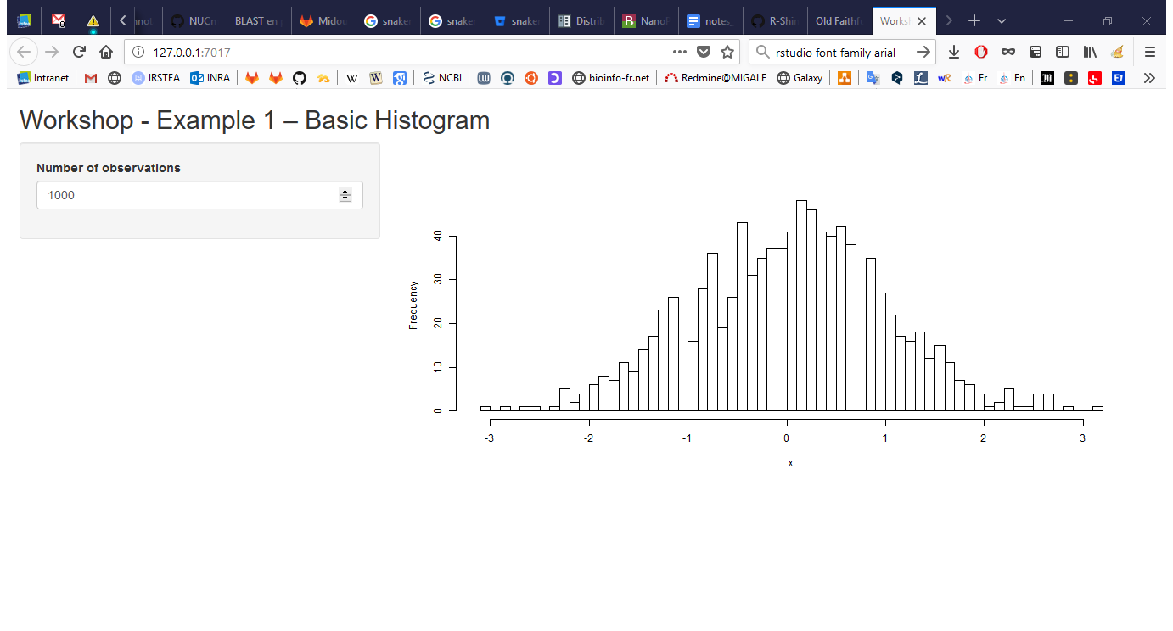
My first Shiny app

Slide 51
My first Shiny app
ui <- fluidPage(
titlePanel("Workshop - Example 1 – Basic Histogram"),
sidebarLayout(
sidebarPanel(
numericInput(inputId="n",
label="Number of observations", value=1000) ),
mainPanel(plotOutput("plot"))
)
)
server <- function(input, output) {
data <- reactive({
x <- rnorm(input$n)
x })
output$plot <- renderPlot({
hist(data(), 50, main="", xlab="x")
})
}

Slide 52
My first Shiny app
ui <- fluidPage(
titlePanel("Workshop - Example 1 – Basic Histogram"),
sidebarLayout(
sidebarPanel(
numericInput(inputId="n",
label="Number of observations", value=1000) ),
mainPanel(plotOutput("plot"))
)
)
server <- function(input, output) {
data <- reactive({
x <- rnorm(input$n)
x })
output$plot <- renderPlot({
hist(data(), 50, main="", xlab="x")
})
}

Slide 53
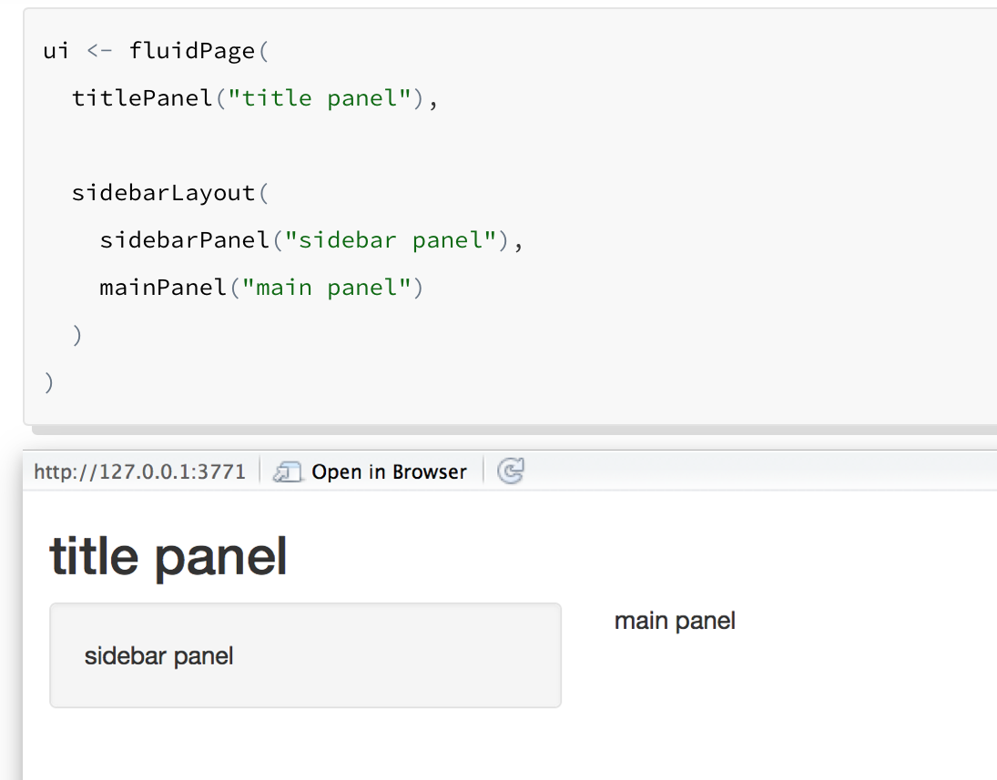
My first Shiny app
ui <- fluidPage(
titlePanel("Workshop - Example 1 – Basic Histogram"),
sidebarLayout(
sidebarPanel(
numericInput(inputId="n",
label="Number of observations", value=1000) ),
mainPanel(plotOutput("plot"))
)
)
server <- function(input, output) {
data <- reactive({
x <- rnorm(input$n)
x })
output$plot <- renderPlot({
hist(data(), 50, main="", xlab="x")
})
}
Most shiny apps use fluidPage():
Creates a page with rows (for element alignment), which contain columns
Fluid pages adapt the size of components according to available space (browser width)

Slide 54
My first Shiny app
ui <- fluidPage(
titlePanel("Workshop - Example 1 – Basic Histogram"),
sidebarLayout(
sidebarPanel(
numericInput(inputId="n",
label="Number of observations", value=1000) ),
mainPanel(plotOutput("plot"))
)
)
server <- function(input, output) {
data <- reactive({
x <- rnorm(input$n)
x })
output$plot <- renderPlot({
hist(data(), 50, main="", xlab="x")
})
}

Slide 55
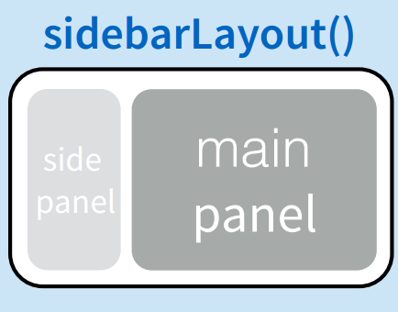
My first Shiny app
ui <- fluidPage(
titlePanel("Workshop - Example 1 – Basic Histogram"),
sidebarLayout(
sidebarPanel(
numericInput(inputId="n",
label="Number of observations", value=1000) ),
mainPanel(plotOutput("plot"))
)
)
server <- function(input, output) {
data <- reactive({
x <- rnorm(input$n)
x })
output$plot <- renderPlot({
hist(data(), 50, main="", xlab="x")
})
}

Slide 56
My first Shiny app
ui <- fluidPage(
titlePanel("Workshop - Example 1 – Basic Histogram"),
sidebarLayout(
sidebarPanel(
numericInput(inputId="n",
label="Number of observations", value=1000) ),
mainPanel(plotOutput("plot"))
)
)
server <- function(input, output) {
data <- reactive({
x <- rnorm(input$n)
x })
output$plot <- renderPlot({
hist(data(), 50, main="", xlab="x")
})
}

Slide 57
My first Shiny app
ui <- fluidPage(
titlePanel("Workshop - Example 1 – Basic Histogram"),
sidebarLayout(
sidebarPanel(
numericInput(inputId="n",
label="Number of observations", value=1000) ),
mainPanel(plotOutput("plot"))
)
)
server <- function(input, output) {
data <- reactive({
x <- rnorm(input$n)
x })
output$plot <- renderPlot({
hist(data(), 50, main="", xlab="x")
})
}

Slide 58
My first Shiny app
ui <- fluidPage(
titlePanel("Workshop - Example 1 – Basic Histogram"),
sidebarLayout(
sidebarPanel(
numericInput(inputId="n",
label="Number of observations", value=1000) ),
mainPanel(plotOutput("plot"))
)
)
server <- function(input, output) {
data <- reactive({
x <- rnorm(input$n)
x })
output$plot <- renderPlot({
hist(data(), 50, main="", xlab="x")
})
}

Slide 59
My first Shiny app
ui <- fluidPage(
titlePanel("Workshop - Example 1 – Basic Histogram"),
sidebarLayout(
sidebarPanel(
numericInput(inputId="n",
label="Number of observations", value=1000) ),
mainPanel(plotOutput("plot"))
)
)
server <- function(input, output) {
data <- reactive({
x <- rnorm(input$n)
x })
output$plot <- renderPlot({
hist(data(), 50, main="", xlab="x")
})
}

Slide 60
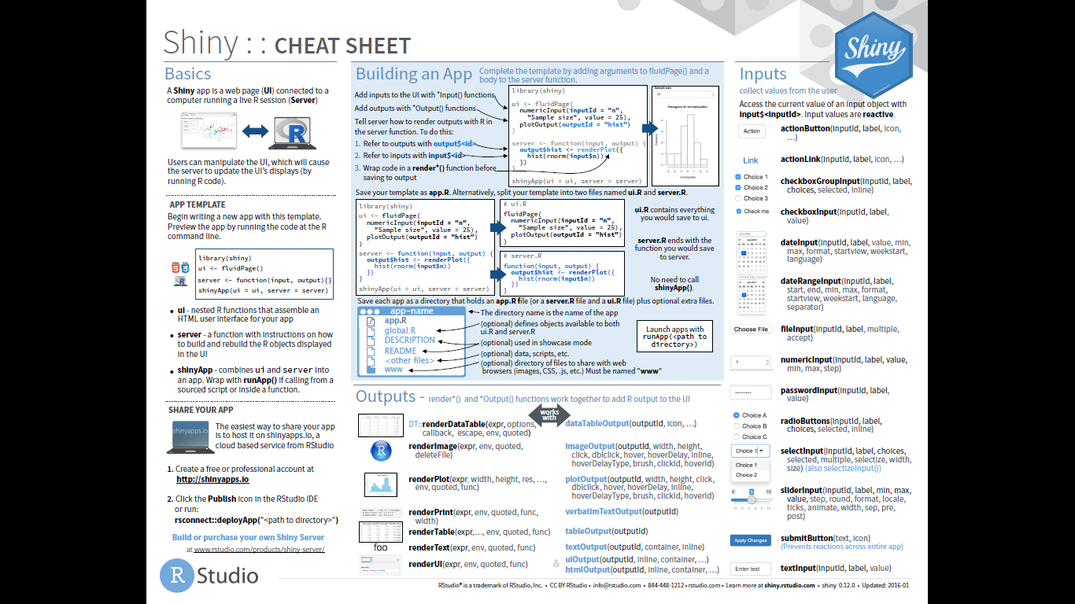
Standard shiny input widgets

Slide 61
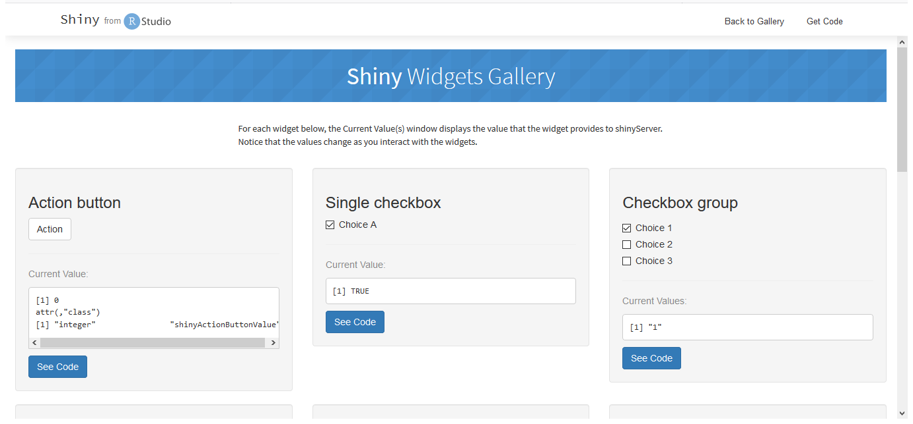
Standard shiny input widgets
https://shiny.rstudio.com/gallery/widget-gallery.html

Slide 62
Standard shiny input widgets
ui <- fluidPage(
titlePanel("Workshop - Example 1 – Basic Histogram"),
sidebarLayout(
sidebarPanel(
numericInput(inputId="n",
label="Number of observations", value=1000) ),
mainPanel(plotOutput("plot"))
)
)
server <- function(input, output) {
data <- reactive({
x <- rnorm(input$n)
x })
output$plot <- renderPlot({
hist(data(), 50, main="", xlab="x")
})
}
Creates an entry at input$n
Default value
The remaining arguments vary from widget to widget, depending on what the widget needs to do its job.

Slide 63
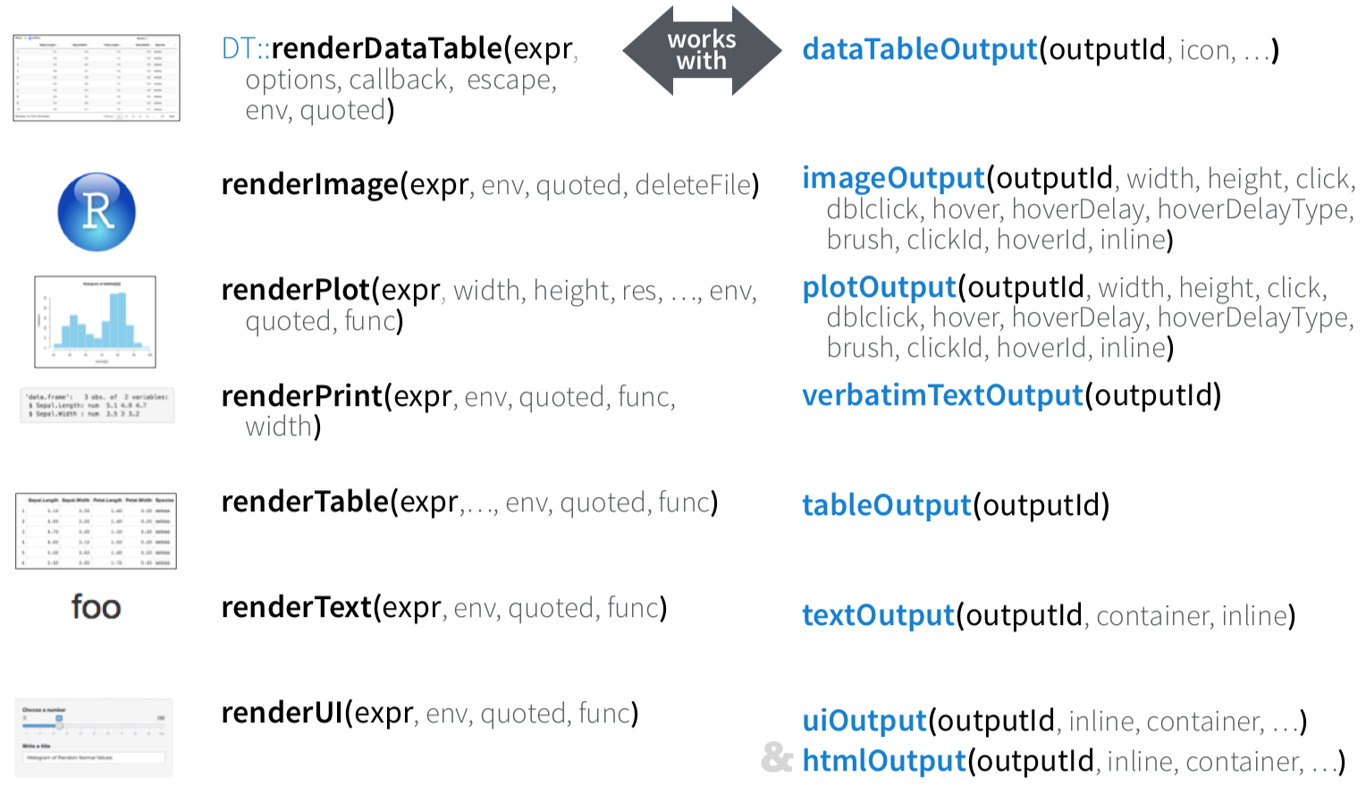
Render and outputs
render*() and *Output() functions work together to add R output to the UI
server
ui

Slide 64
Render and outputs
ui <- fluidPage(
titlePanel("Workshop - Example 1 – Basic Histogram"),
sidebarLayout(
sidebarPanel(
numericInput(inputId="n",
label="Number of observations", plotOutput("plot") value=1000) ),
mainPanel()
)
)
server <- function(input, output) {
data <- reactive({
x <- rnorm(input$n)
x })
output$plot <- renderPlot({
hist(data(), 50, main="", xlab="x")
})
}

Slide 65
My first Shiny app
Others ways to run my app ?

Slide 66
Running the Shiny app
Copy/paste the content of app.R or source() its content: app <- source("app.R") app
Use the runApp() function: runApp("test") # Directory runApp("test/app.R") # File
Use RStudio

Slide 67
More about running the shiny app
Run an app from github: runGitHub( repo="shiny", username="lecy")
Run the app in "showcase mode" (run app and show source code) runApp("test", display.mode = "showcase")

Slide 68
More about running the shiny app
> library(shiny)
> app <- source("test1/app.R")
> app
$value
Listening on http://127.0.0.1:3625
^C
> runApp("test1/app.R")
Listening on http://127.0.0.1:3625
Warning in body(fun) : argument is not a function
^C

Slide 69
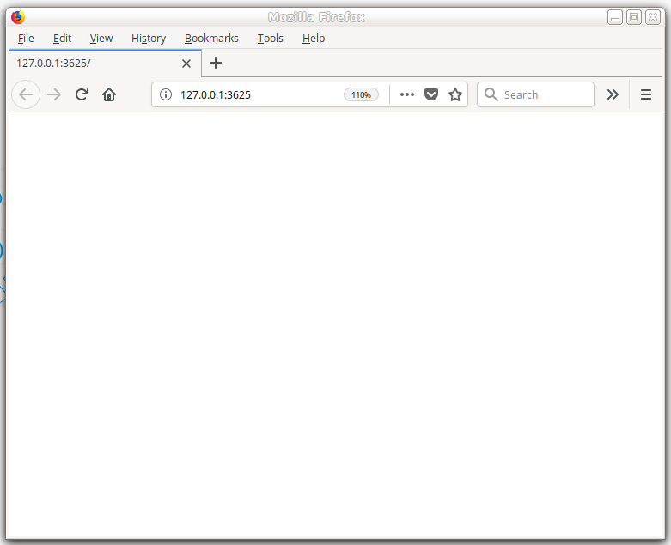
More about running the shiny app
> library(shiny)
> app <- source("test1/app.R")
> app
$value
Listening on http://127.0.0.1:3625
^C
> runApp("test1/app.R")
Listening on http://127.0.0.1:3625
Warning in body(fun) : argument is not a function
^C

Slide 70
Exercices
Questions and data are available on GitHub :
https://github.com/IFB-ElixirFr/IFB_Shiny_training/tree/master/exercise1

Slide 71
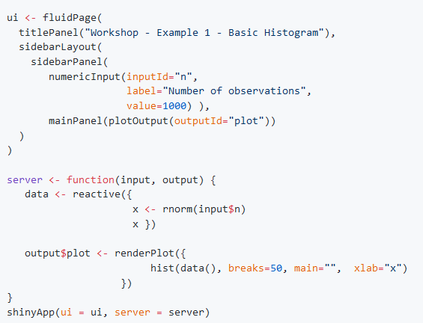
Exercices
#1 – Let us start Copy and run the first application presented today

Slide 72
Exercices
#2 – Bin numbers Change the application to allow the user to enter the numbers of bins when plotting the histogram.

Slide 73
Exercices – #2 : Bin numbers
ui <- fluidPage(
titlePanel("Workshop - Example 1 – Basic Histogram"),
sidebarLayout(
sidebarPanel(
numericInput(inputId = "n",
label = "Number of observations",
value = 1000),
numericInput(inputId = "bins",
label = "Number of bins",
value = 25)
),
mainPanel(plotOutput("plot"))
)
)
server <- function(input, output) {
data <- reactive({
x <- rnorm(input$n)
x })
output$plot <- renderPlot({
hist(data(), input$bins, main = "", xlab = "x")
})
}
shinyApp(ui = ui, server = server)

Slide 74
Exercices
#3 – Add some text to the output Change the application to add some text to the output. For example, indicate the number of observations and bins defined in parameters.

Slide 75
Exercices – #3 : Add some text to the output
ui <- fluidPage(
titlePanel("Workshop - Example 1 – Basic Histogram"),
sidebarLayout(
sidebarPanel(
numericInput(inputId = "n",
label = "Number of observations",
value = 1000),
numericInput(inputId = "bins",
label = "Number of bins",
value = 25)
),
mainPanel(
plotOutput("plot"),
textOutput("hello"),
textOutput("params")
)
)
)
server <- function(input, output) {
data <- reactive({
x <- rnorm(input$n)
x })
output$plot <- renderPlot({
hist(data(), input$bins, main = "", xlab = "x")
})
output$hello <- renderText({
"Random histogram"
})
output$params <- renderText({
paste0("Parameters: ",
" n = ", input$n, "; bins = ", input$bins)
})
}
shinyApp(ui = ui, server = server)

Slide 76
Exercices
#4 – Choose mean and standard deviation
Change the application so that
The user can enter different values for the mean and standard deviation.
The mean and standard deviation are shown in the mainPanel.
The user can enter a title for the histogram.

Slide 77
Exercices – #4 : Choose mean and standard deviation
ui <- fluidPage(
titlePanel("Workshop - Example 1 – Basic Histogram"),
sidebarLayout(
sidebarPanel(
sidebarPanel(
textInput(inputId = "main", label = "Plot title", value = "Random sampling distribution"),
numericInput(inputId = "mean",
label = "Mean",
value = 5),
numericInput(inputId = "sd",
label = "Standard deviation",
value = 2),
numericInput(inputId = "n",
label = "Number of observations",
value = 1000),
numericInput(inputId = "bins",
label = "Number of bins",
value = 25)
),
mainPanel(
plotOutput("plot"),
textOutput("hello"),
textOutput("params"),
textOutput("mean"),
textOutput("sd")
)
)
)
server <- function(input, output) {
data <- reactive({
x <- rnorm(n = input$n, mean = input$mean, sd = input$sd)
x })
output$plot <- renderPlot({
hist(data(), input$bins, xlab = "x", main = input$main);
abline(v = input$mean, col = "blue", lwd = 2)
})
output$hello <- renderText({
"Random histogram"
})
output$params <- renderText({
paste0("Parameters: ",
" n = ", input$n, "; bins = ", input$bins)
})
output$mean <- renderText({
paste0("Mean = ", input$mean)
})
output$sd <- renderText({
paste0("Sd = ", input$sd)
})
}
shinyApp(ui = ui, server = server)

Slide 78
Exercices
#5 – Different display Change the application so that the user can choose to do a histogram or a boxplot

Slide 79
Exercices – #5 : Different display
ui <- fluidPage(
titlePanel("Workshop - Example 1 – Basic Histogram"),
sidebarLayout(
sidebarPanel(
sidebarPanel(
textInput(inputId = "main", label = "Plot title", value = "Random sampling distribution"),
numericInput(inputId = "mean",
label = "Mean",
value = 5),
numericInput(inputId = "sd",
label = "Standard deviation",
value = 2),
numericInput(inputId = "n",
label = "Number of observations",
value = 1000),
numericInput(inputId = "bins",
label = "Number of bins",
value = 25),
radioButtons("plottype", "Plot type:",
c("Histogram" = "hist",
"Boxplot" = "boxplot"))
),
mainPanel(
plotOutput("plot"),
textOutput("hello"),
textOutput("params"),
textOutput("mean"),
textOutput("sd")
) ) )
server <- function(input, output) {
data <- reactive({
x <- rnorm(n = input$n, mean = input$mean, sd = input$sd)
x })
output$plot <- renderPlot({
if (input$plottype == "hist") {
hist(data(), input$bins, xlab = "x", main = input$main);
abline(v = input$mean, col = "blue", lwd = 2)
} else if (input$plottype == "boxplot") {
boxplot(data(), xlab = "x", main = input$main)
}
})
output$hello <- renderText({
"Random histogram"
})
output$params <- renderText({
paste0("Parameters: ",
" n = ", input$n, "; bins = ", input$bins)
})
output$mean <- renderText({
paste0("Mean = ", input$mean)
})
output$sd <- renderText({
paste0("Sd = ", input$sd)
})
}
shinyApp(ui = ui, server = server)

Slide 80
Exercices
#6 – Change the appearance of the widgets
You can customize the size of the bars and plots:
Change the size of the sidebar; the "width" option of the sidebarPanel accepts values between 1 and 12.
Change the aspect ratio of the graph: plotOutput("plot", width="500px", height = "500px")

Slide 81
Exercices – #6 : Change the appearance of the widgets
ui <- fluidPage(
titlePanel("Workshop - Example 1 – Basic Histogram"),
sidebarLayout(
sidebarPanel(
sidebarPanel(
width=3,
textInput(inputId = "main", label = "Plot title", value = "Random sampling distribution"),
numericInput(inputId = "mean",
label = "Mean",
value = 5),
numericInput(inputId = "sd",
label = "Standard deviation",
value = 2),
numericInput(inputId = "n",
label = "Number of observations",
value = 1000),
numericInput(inputId = "bins",
label = "Number of bins",
value = 25),
radioButtons("plottype", "Plot type:",
c("Histogram" = "hist",
"Boxplot" = "boxplot"))
),
mainPanel(
plotOutput("plot", width = "500px", height = "500px"),
textOutput("hello"),
textOutput("params"),
textOutput("mean"),
textOutput("sd")
) ) )
server <- function(input, output) {
data <- reactive({
x <- rnorm(n = input$n, mean = input$mean, sd = input$sd)
x })
output$plot <- renderPlot({
if (input$plottype == "hist") {
hist(data(), input$bins, xlab = "x", main = input$main);
abline(v = input$mean, col = "blue", lwd = 2)
} else if (input$plottype == "boxplot") {
boxplot(data(), xlab = "x", main = input$main)
}
})
output$hello <- renderText({
"Random histogram"
})
output$params <- renderText({
paste0("Parameters: ",
" n = ", input$n, "; bins = ", input$bins)
})
output$mean <- renderText({
paste0("Mean = ", input$mean)
})
output$sd <- renderText({
paste0("Sd = ", input$sd)
})
}
shinyApp(ui = ui, server = server)

Slide 82
Exercices
#7 – Panel appears and disappears An ugly feature of our application:
The input field Number of bins only makes sense for the histogram, not for the boxplot, so it should not appear when we do a boxplot.
Hint: use the conditionalPanel() function.

Slide 83
Exercices – #7 : Panel appears and disappears
# Only show the option "Number of bins" if the plot type is a histogram,
# since this parameter makes no sense for the other plot type (boxplot)
conditionalPanel(
condition = "input.plotType == 'hist'",
numericInput(inputId = "bins",
label = "Number of bins",
value = 25)
),
output$params <- renderText({
if (input$plotType == "hist") {
paste0("Parameters: ",
" n = ", input$n, "; bins = ", input$bins)
} else {
paste0("Parameters: n = ", input$n)
}
})

Slide 84
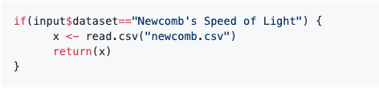
Exercices
#8 – Access predefined data sets
Save the data sets in the same folder as app.R
GitHub contains 3 datasets that you can use: euros, forbes, newcomb.
Let the user choose (using a drop down menu) to either generate the random data or use one of several datafiles.
We can read the data in the server with a command like

Slide 85
Exercices – #8 : Access predefined data sets
## Choose the data type between 4 options
## - random number sampling
## - Newcomb dataset (loaded from file)
## - Euros dataset (loaded from file)
## - Forbes dataset (loaded from file)
selectInput("dataset", "Data type",
c("Random numbers" = "rand",
"Newcomb's Speed of Light" = "newcomb",
"Euros" = "euros",
"Forbes" = "forbes"
),
multiple = FALSE, selectize = TRUE, width = "300px"),
## For the Forbes dataset, enable the user to
## specify the column of values to analyse
conditionalPanel(
condition = "input.dataset == 'forbes'",
selectInput("column", "Data column",
c("Assets",
"Sales",
"Market_Value",
"Profits",
"Cash_Flow",
"Employees"))
),
data <- reactive({
if (input$dataset == "newcomb") {
message("Loading Newcomb dataset")
x <- list(
values = unlist(read.csv("newcomb.csv")[2]),
main = "Newcomb")
} else if (input$dataset == "forbes") {
message("Loading Forbes dataset")
forbes <- read.csv("forbes.csv") ## Load the forbes data table
x <- list(
values = forbes[, input$column], ## select the user-specified column
main = paste("Forbes", input$column))
} else if (input$dataset == "euros") {
message("Loading Euros dataset")
x <- list(
values = unlist(read.delim("euros.tsv")[1]),
main = "Euros")
} else if (input$dataset == "rand") {
message("Generating random numbers")
x <- list(
values = rnorm(n = input$n, mean = input$mean, sd = input$sd),
main = input$main)
} else {
stop("Invalid dataset")
}
return(x)
})

Slide 86
Exercices
#9 – Dataset upload
Let the user upload its own dataset (a file containing one value per row, no headers) so that it is plotted by the app.
Hint: use the fileInput() function ; note that this function does not return the file itself, but a structure containing metadata about the file, including a link that you can then use to open the file (have a look at the help page for more information).
Add an output widget that displays the content of the file as a table
Hint: use the tableOutput() widget.

Slide 87
Exercices – #9 :Dataset upload
selectInput("dataset", "Data type",
c("Random numbers" = "rand",
"Newcomb's Speed of Light" = "newcomb",
"Euros" = "euros",
"Forbes" = "forbes",
"My own dataset" = "mydata"
)
## Display the file input and the title panel only if
## the user want to use his dataset.
conditionalPanel(
condition = "input.dataset == 'mydata'",
fileInput(inputId = "myfile", label = "Upload your data (one value per row)"),
textInput(inputId = "main", label = "Plot title", value = "My data sampling distribution")
)
data <- reactive({
if (input$dataset == "newcomb") {
message("Loading Newcomb dataset")
x <- list(
values = unlist(read.csv("newcomb.csv")[2]),
main = "Newcomb")
} else if (input$dataset == "rand") {
message("Generating random numbers")
x <- list(
values = rnorm(n = input$n, mean = input$mean, sd = input$sd),
main = input$main)
} else if (input$dataset == "mydata") {
message("Loading your own dataset")
inFile <- input$myfile
if (is.null(inFile)) {
x <- list(
values = rnorm(input$n),
main = input$main)
} else {
x <- list(
values = read.csv(inFile$datapath, header=FALSE)[,1],
main = input$main)
}
return(x)
} else {
stop("Invalid dataset")
}
return(x)
})

Slide 88
Exercices
#10 – Several tabs Often it is a good idea to have several tabs to organize the output when showing different information. Say we want to separate the text, the graph and the table display
Hint: look at the tabsetPanel() function.

Slide 89
Exercices – #10 :Several tabs
mainPanel(
tabsetPanel(
tabPanel("Plot",
plotOutput("plot", height="500px", width="500px") # Panel to display the plot
),
tabPanel("Table",
tableOutput("datatable") # Panel to display the table
),
tabPanel("Summary",
textOutput("hello"), # Panel to display the title
textOutput("params"), # Panel to display the parameters
textOutput("mean"), # Panel to display the standard deviation
textOutput("sd") # Panel to display the mean
)
)
)

Slide 90
Exercices
#11 – Use another library Let us draw the graphs with ggplot2 instead of base R. For this purpose, you must add require(ggplot2) on server side and change the render plot function call for histogram and boxplot

Slide 91
Exercices – #11 :Use another library
## Draw the plot
output$plot <- renderPlot({
if (input$plotType == "hist") {
## Histogram
ggplot(as.data.frame(data()$values), aes(x=data()$values)) +
geom_histogram(bins=input$bins, color="black", fill="white") +
geom_vline(aes(xintercept=input$mean), color="blue", linetype="dashed", size=1) +
labs(title=data()$main, x="x")
} else if (input$plotType == "boxplot") {
## Boxplot
ggplot(as.data.frame(data()$values), aes(y=data()$values)) +
geom_boxplot() +
labs(title=data()$main, x="x", y="")
#boxplot(data()$values, xlab = "x", main = data()$main)
}
})

Slide 92
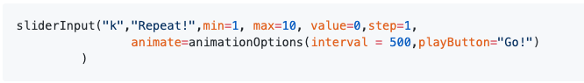
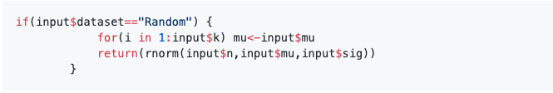
Exercices
#12 – Animation
When generating random data we might want to do this a number of times. Slowly, so one can watch the changes.
On ui side use :
On server side use:

Slide 93
Exercices
#13 – Conditional widgets Again, at this point, there are items on the left that only make sense in some cases, so they should only appear when needed. For example, the graph options should only be present when the the Graph tab is selected.
Again, conditionalPanel() to the rescue!

Slide 94
Exercices – #13 : Conditional widgets
condition = "input.dataset == 'rand' && input.tabs == 'plot'",
mainPanel(
tabsetPanel(
id = "tabs",
tabPanel("Plot", value="plot",
plotOutput("plot", height="500px", width="500px") # Panel to display the plot
),
tabPanel("Table", value="table",
tableOutput("datatable") # Panel to display the table
),
tabPanel("Summary", value="summary",
textOutput("hello"), # Panel to display the title
textOutput("params"), # Panel to display the parameters
textOutput("mean"), # Panel to display the standard deviation
textOutput("sd") # Panel to display the mean
)
)
)

Slide 95
Exercices
#14 – Summary statistics In the text area we want a table of summary statistics.
The idea here is to use R syntax to create a character vector which has the lines of the HTML code.

Slide 96
Exercices – #14 : Summary statistics
tabPanel("Summary", value="summary",
uiOutput("title"),
uiOutput("summary"),
… )
output$title <- renderUI(HTML("<h4>", data()$main,"</h4>"))
## Display a HTML summary table of parameters and statistics
output$summary <- renderUI({
if (input$dataset == "rand") {
if (input$plotType == "hist") {
params_header <- HTML("<th>Sample size</th><th>Bins</th>")
params_raw <- HTML("<td>", input$n,"</td><td>", input$bins,"</td>")
} else {
params_header <- HTML("<th>Sample Size</th>")
params_raw <- HTML("<td>", input$n,"</td>")
}
} else {
if (input$plotType == "hist") {
params_header <- HTML("<th>Bins</th>")
params_raw <- HTML("<td>", input$bins,"</td>")
}
}
HTML("<table border=1>
<tr>", params_header,"
<th>Mean</th>
<th>Standard deviation</th>
</tr>
<tr>", params_raw,"
<td>", signif(digits = 3, mean(data()$values)),"</td>
<td>", signif(digits = 3, sd(data()$values)),"</td>
</tr>
</table><br>")
})

Slide 97
Exercices
#15 – Table presentation These tables rarely look very good. To change their appearance we need to use cascading style files.
The easiest way is to include that in the ui.R

Slide 98
Exercices – #15 :Table presentation
includeCSS("styles.css"),
styles.css:
table {
width: 100%;
}
th, td {
height: 50px;
text-align: center;
}
th {
background-color: #C0C0C0;
}
h4 {
text-decoration: underline;
}

Slide 99
Exercices
#16 – Download a file The user download a file produced by the application

Slide 100
Exercices – #16 :Download a file
conditionalPanel(
condition = "input.tabs == 'plot'",
downloadButton('downloadPlot', 'Download Plot')
)
plot <- reactive({ … })
# Download PNG file for the plot
output$downloadPlot <- downloadHandler(
filename = function() { paste0(data()$main, " ", input$plotType, '.png', sep='') },
content = function(file) {
png(file)
print(plot())
dev.off()
}
)
## Draw the plot
output$plot <- renderPlot({
plot()
})

Slide 101
Exercices
#17 – Use the plotly or D3 libraries

Slide 102
Exercices – #17 :Use the plotly or D3 libraries
plotlyOutput("plot", height="500px", width="500px") # Panel to display the plot
## Draw the plot
output$plot <- renderPlotly({
plot()
})

Slide 103
Deploy shiny app on the web

Slide 104
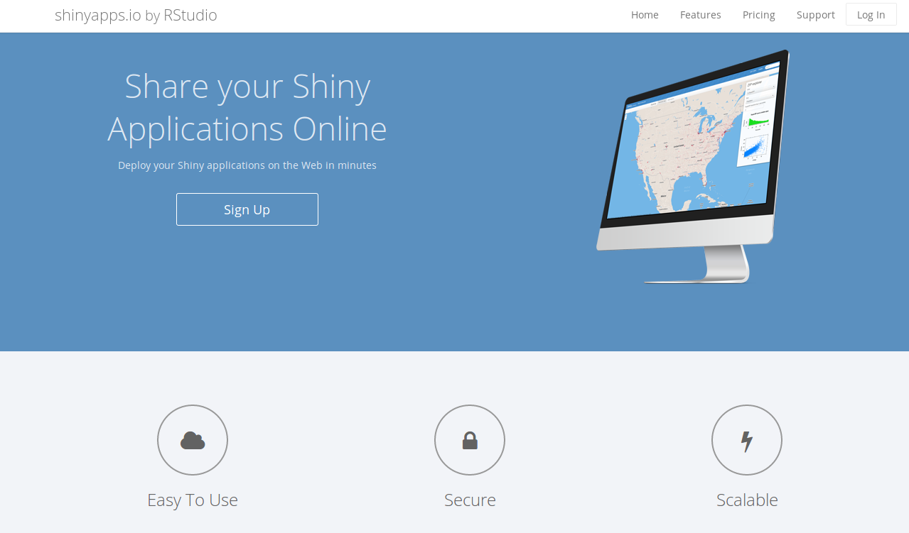
The Rstudio documentation
https://shiny.rstudio.com/articles/deployment-web.html

Slide 105
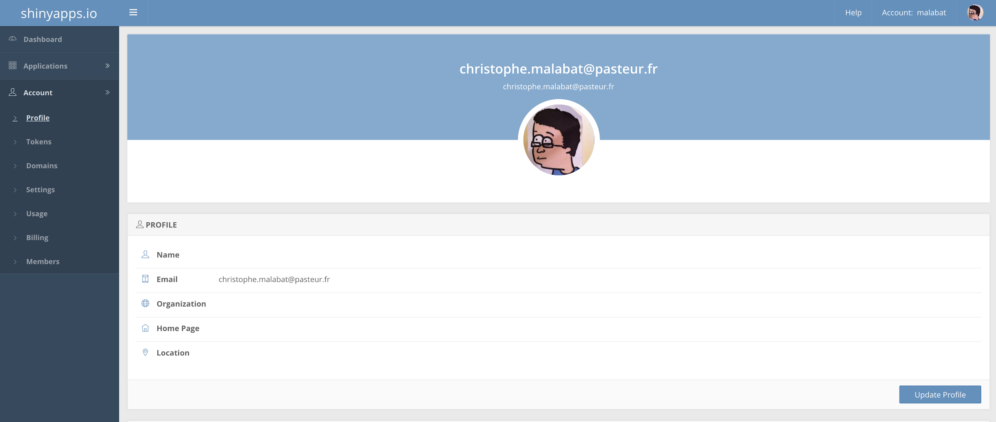
Shinyapps.io
First install rsconnect in Rstudio
install.packages('rsconnect')
Then create an account on shinyapp.io
https://www.shinyapps.io/

Slide 106
Shinyapps.io
Copy the token into Rstudio
rsconnect::setAccountInfo(name='malabat',
token='630DC388B2F1E7555A63681A5B847015',
secret='<SECRET>')
Don’t forget to show the ‘<SECRET>’ part before copying.
Deploy the app
rsconnect::deployApp('path/to/your/app', account = 'yourAccountName')

Slide 107
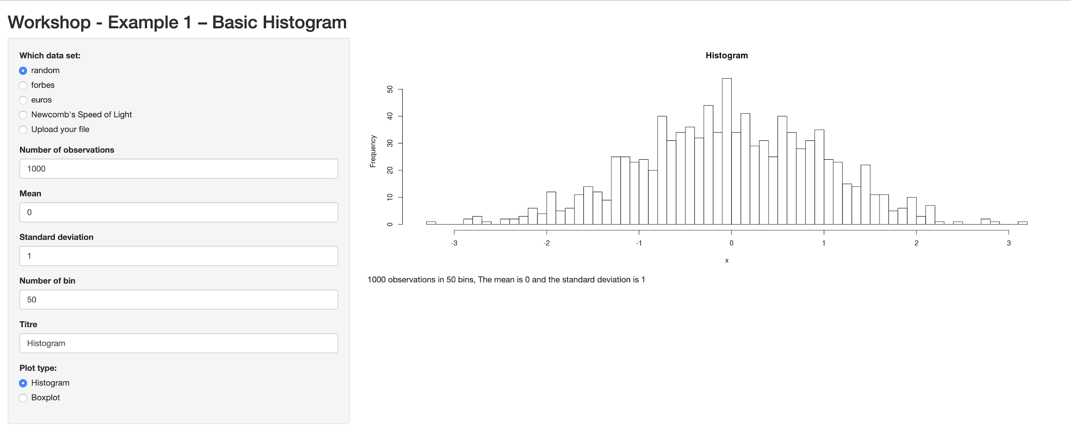
Shinyapps.io
The app is online
https://malabat.shinyapps.io/shiny/

Slide 108
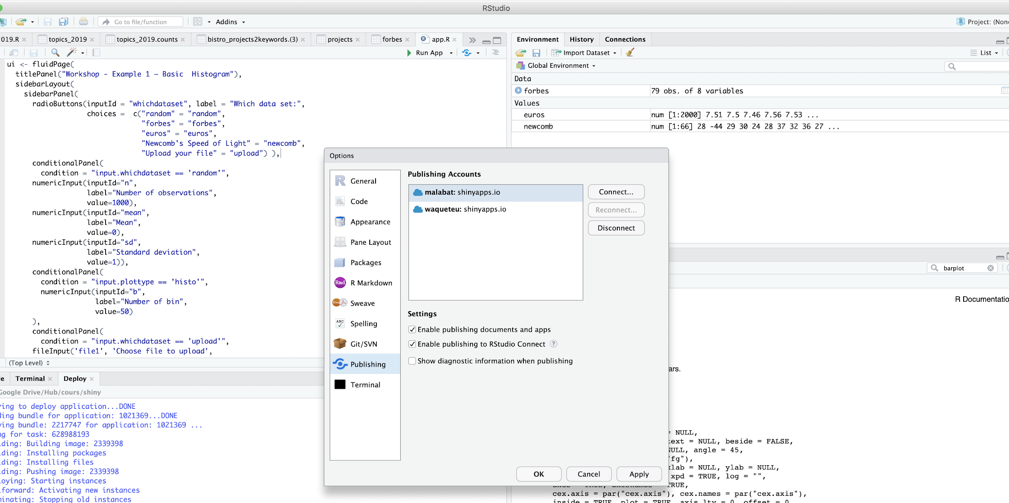
Shinyapps.io – Publish with Rstudio
After doing rsconnect, your account is configured into Rstudio - Go to publish menu for finding it

Slide 109
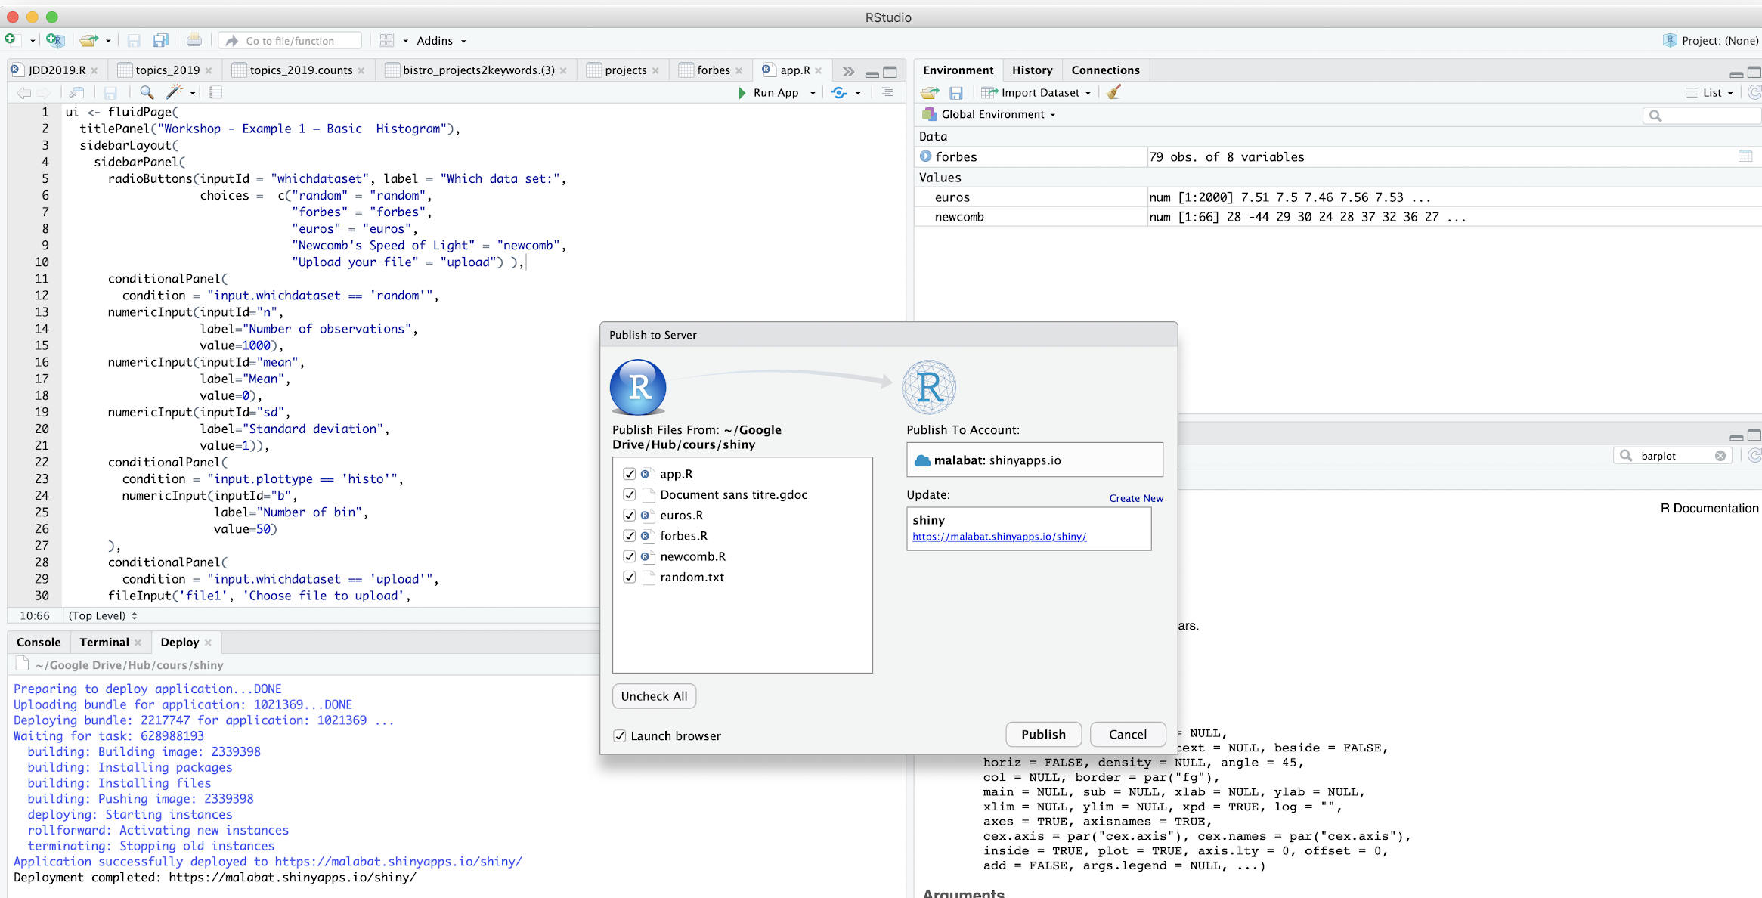
Shinyapps.io – Publish with Rstudio
After doing rsconnect, your account is configured into Rstudio - Go to publish menu for finding it
Publish!

Slide 110
Shiny server & shiny server pro
Install shiny server
Install shiny R with apt-get for example
Install shiny in R with install.packages()
Start shiny server
sudo systemctl start shiny-server
Copy the app files in a directory
scp path/to/my/app name@myserver:remotepath/to/my/app
Configure shiny-server.conf

Slide 111
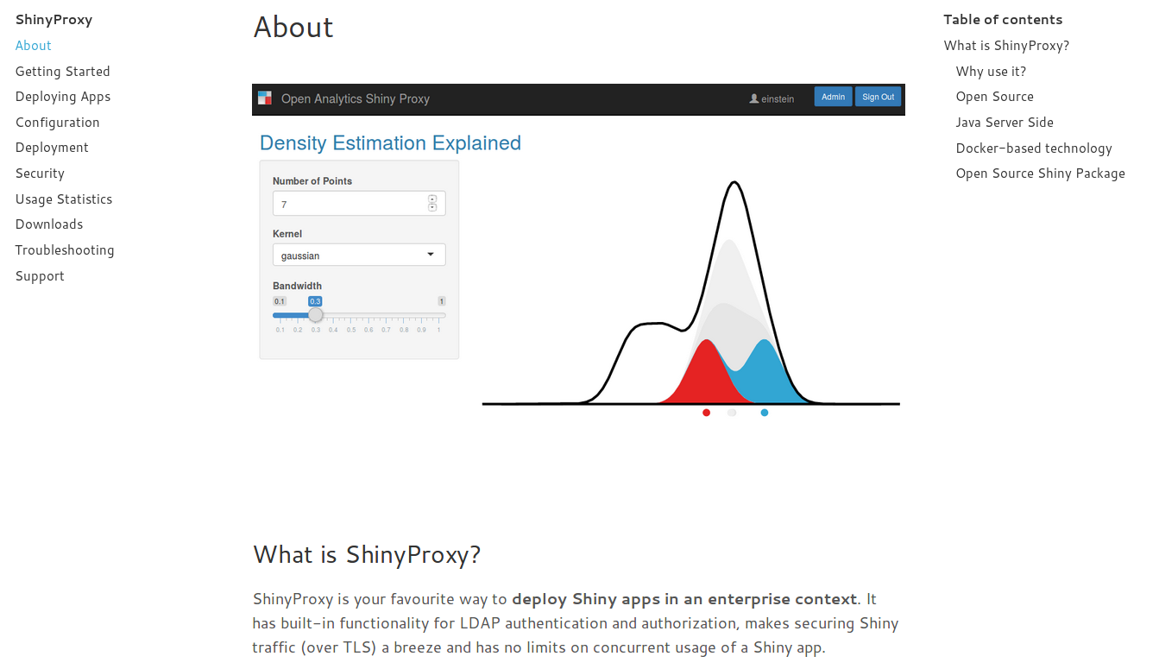

shinyproxy

Slide 112
the pros and cons
 | Infrastructure needed | Costs | Ease of installation | Skills needed for deployment
shinyapps.io | None needed | - free for 5 apps/25h usage - paying service for more important needs | No installation needed | No skills needed
shinyserver open source | ++ | free with limited capabilities 5000 €/year for full version | Installation relatively easy on ubuntu Maintenance easy for systems administrators | few skills in unix
shinyproxy | ++ | - free | Installation relativeley easy using docker but docker administration is not so easy | few skills in unix

Slide 113
Shinyapps.io
Troubleshootings
Error in lint(appDir, appFiles, appPrimaryDoc) :
Cancelling deployment: invalid project layout.
The project should have one of the following layouts:
'shiny.R' and 'ui.R' in the application base directory,
'shiny.R' and 'www/index.html' in the application base directory,
'app.R' or a single-file Shiny .R file,
An R Markdown (.Rmd) document,
A static HTML (.html) or PDF (.pdf) document.
'plumber.R' API description .R file
'entrypoint.R' plumber startup script
A tensorflow saved model

Slide 114
Troubleshooting errors on installing rsconnect package
rsconnect packages depends on openssl and curl development packages.
Ubuntu:
If RCurl or openssl fail to install, make sure you have installed the dev packages of curl and openssl:
sudo apt-get install libssl-dev
sudo apt-get install libcurl4-openssl-dev

Slide 115
Troubleshooting errors on deployment
> rsconnect::deployApp("Shiny-SoSV/")
Preparing to deploy application...DONE
Uploading bundle for application: 1021372...Erreur :
* Application depends on package "ggsci" but it is not installed. Please resolve
before continuing.
* Application depends on package "shinyjs" but it is not installed. Please resolve
before continuing.
De plus : Warning messages:
1: In FUN(X[[i]], ...) :
Failed to infer source for package 'ggsci'; using latest available version on CRAN instead
2: In FUN(X[[i]], ...) :
Failed to infer source for package 'shinyjs'; using latest available version on CRAN instead
3: Unable to package DESCRIPTION files: Couldn't find DESCRIPTION file for ggsci
FIX: install missing packages
> install.packages(“ggsci”)
> install.packages("shinyjs")
> rsconnect::deployApp("Shiny-SoSV/")
Preparing to deploy application...DONE
Uploading bundle for application: 1021372...DONE
Deploying bundle: 2217728 for application: 1021372 ...
Waiting for task: 628985176
building: Parsing manifest
building: Building image: 2339381
building: Fetching packages
building: Building package: nlme
building: Building package: Matrix
building: Building package: mgcv
building: Installing packages
building: Installing files
building: Pushing image: 2339381
deploying: Starting instances
rollforward: Activating new instances
success: Stopping old instances
Application successfully deployed to https://jos4uke.shinyapps.io/shiny-sosv/

Slide 116
Déploiement d’une application Shiny à Pasteur

Slide 117
Shiny Server pro à pasteur - organisation des fichiers
Server (Machine virtuelle)
dir 1
fichiers ui.R et server.R et autres
dir 2
fichiers ui.R et server.R et autres
dir 3
fichiers ui.R et server.R et autres
...
fichiers ui.R et server.R et autres

Slide 118
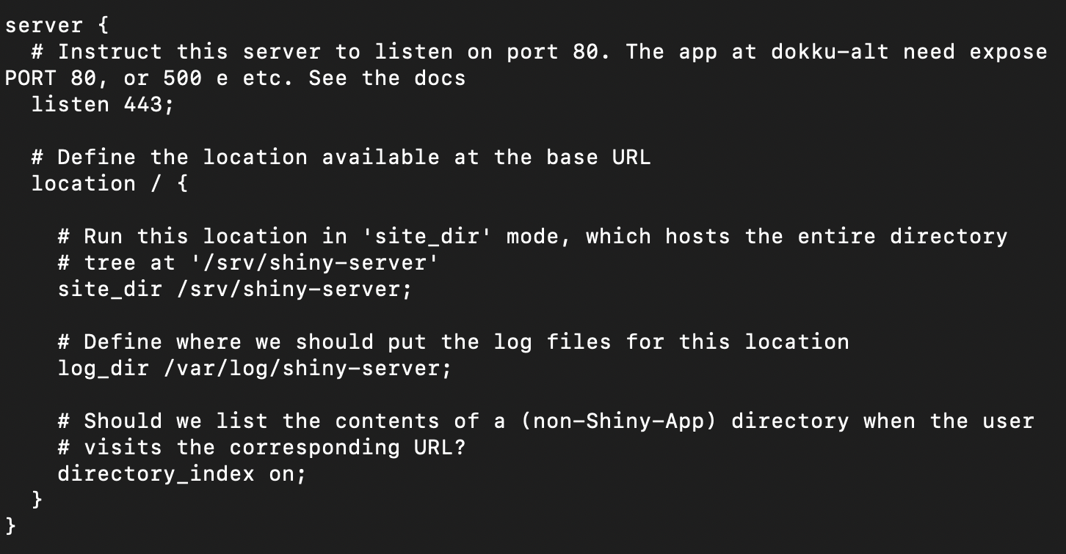
Shiny Server pro à pasteur - fichier de configuration
http://hub05.hosting.pasteur.fr:443/

Slide 119
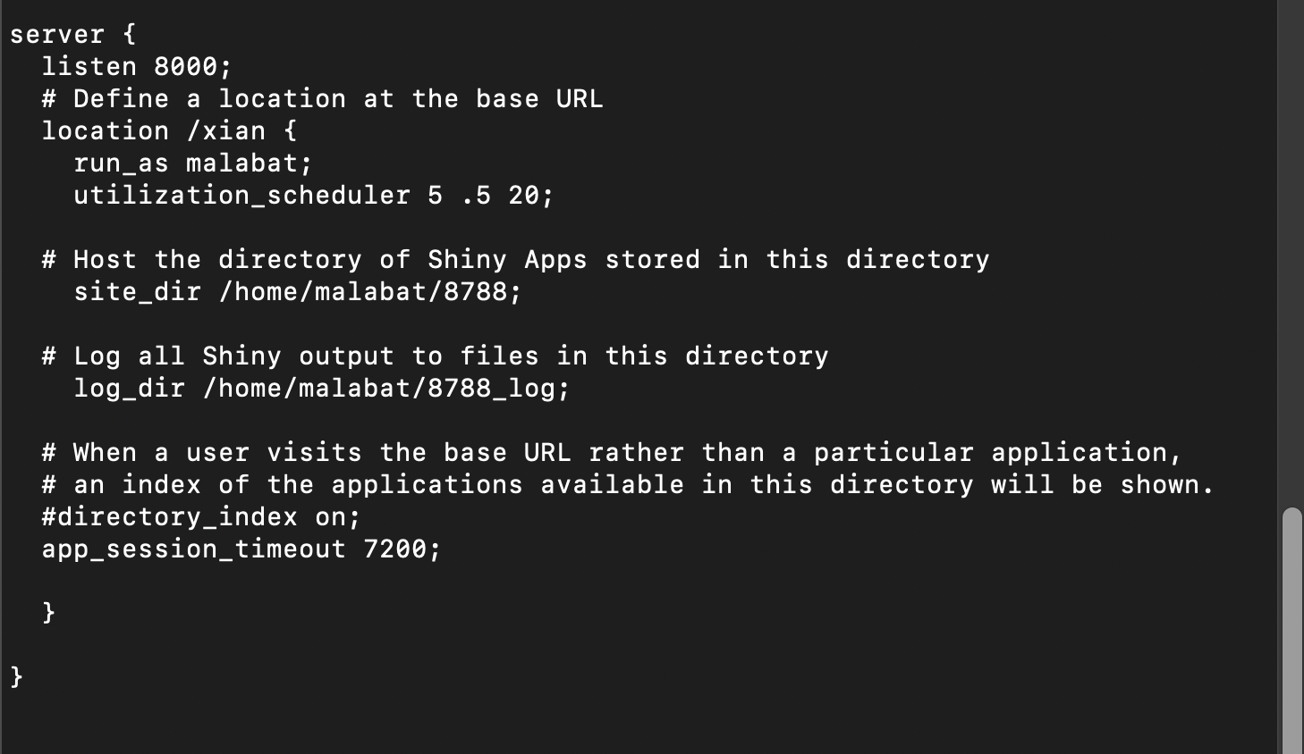
Shiny Server pro à pasteur - fichier de configuration
http://hub05.hosting.pasteur.fr:8000/xian/

Slide 120
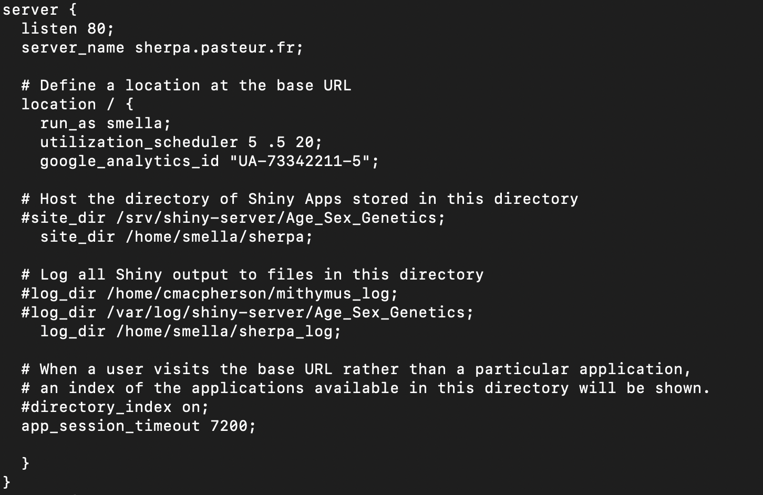
Shiny Server pro à pasteur - fichier de configuration
http://sherpa.pasteur.fr/

Slide 121
Shiny Server pro à pasteur - interface admin
http://hub05.hosting.pasteur.fr:8080

Slide 122
Déploiement d’une application Shiny sur le cloud IFB

Slide 123
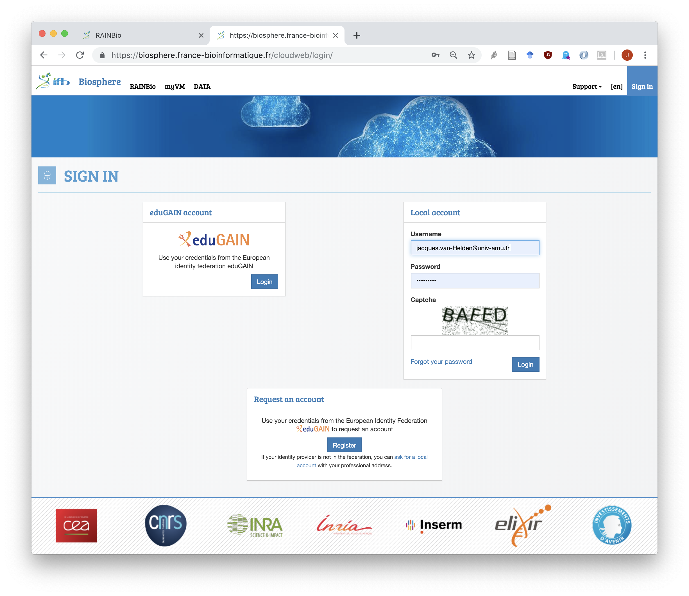
Login
https://biosphere.france-bioinformatique.fr/cloudweb/login/
Request an account
Login
direct login or
via eduGAIN (federation of academic identities)

Slide 124
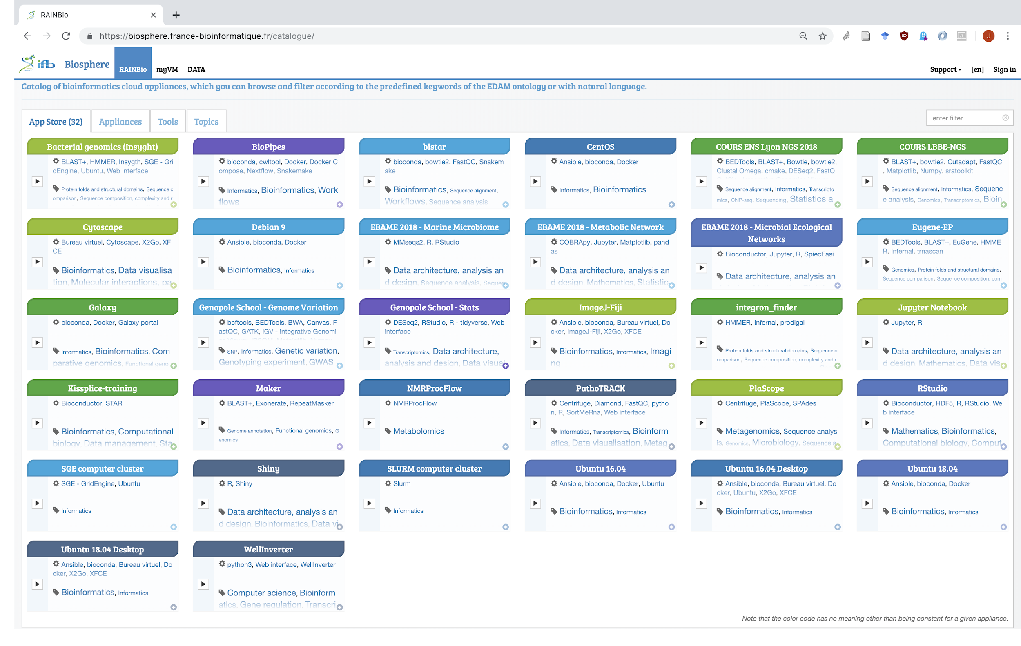
Rainbio – A catalogue of appliances for bioinformatics
Une fédération de clouds
Prérequis
demande de compte cloud
RainBio: catalogue d’appliances
32 appliances (juillet 2019)
génériques (OS Ubuntu)
applications (RStudio, Shiny, Galaxy, CytoScape, ...)
thématiques (bacterial genomics, ...)
https://biosphere.france-bioinformatique.fr/catalogue/

Slide 125
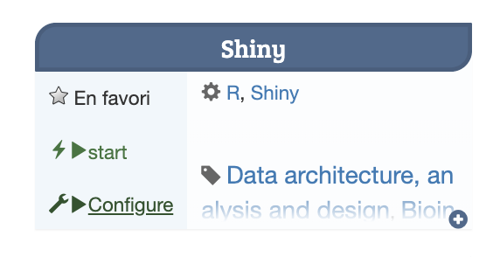
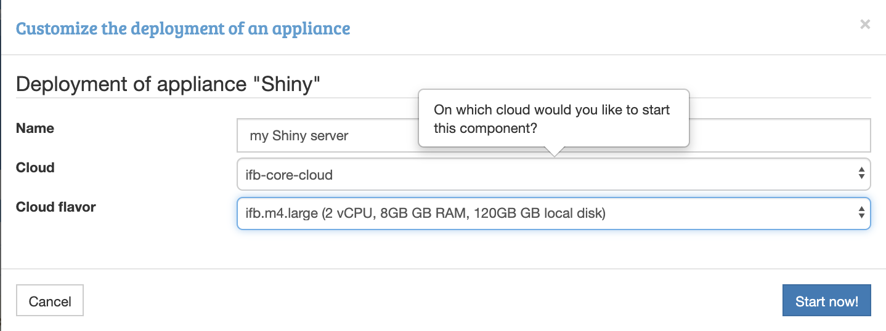
Instantiating your virtual machine (VM) from an appliance
Choose an appliance (image of pre-installed machine), in this case Shiny
Click “Configure”
Type a name for your server
Choose a cloud of the federation (e.g. ifb-core-cloud)
Cloud favor: select the size of your VM (RAM, cores, storage)
Click “Start now”

Slide 126
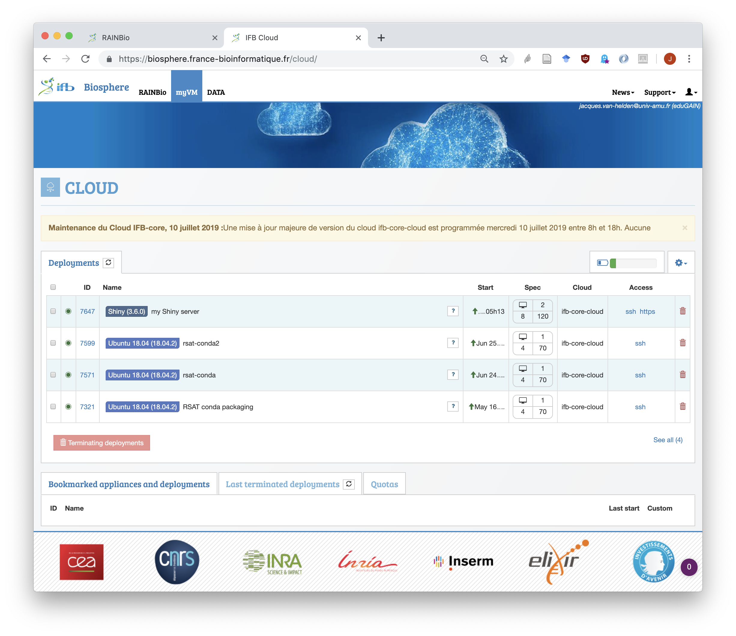
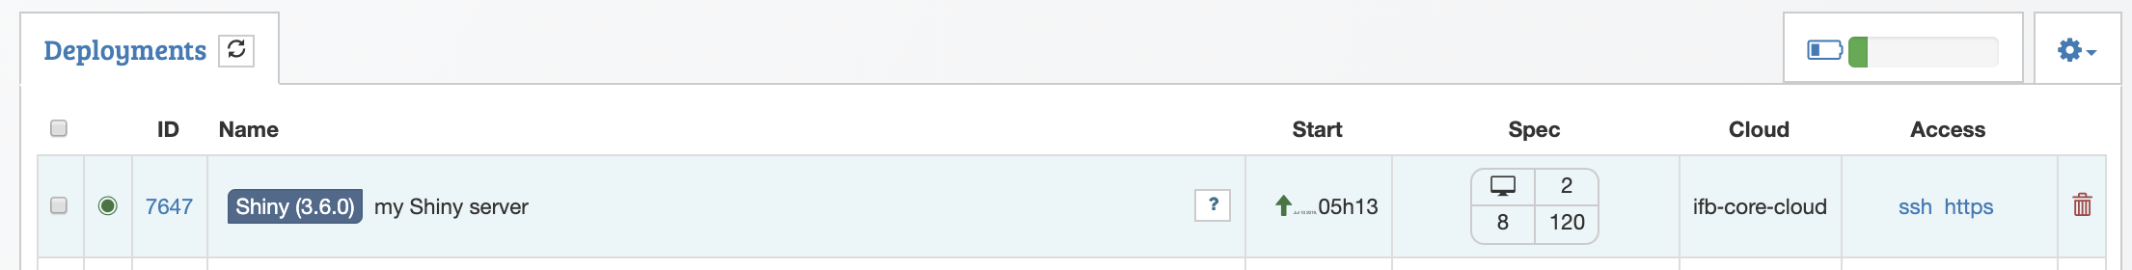
Listing your virtual machine(s)
Click on the tab myVMb
This displays your list of active virtual machine(s)
The Shiny VM takes a few minutes to start.
After that, you can access it either via a terminal (ssh) or via the Web interface (https).

Slide 127
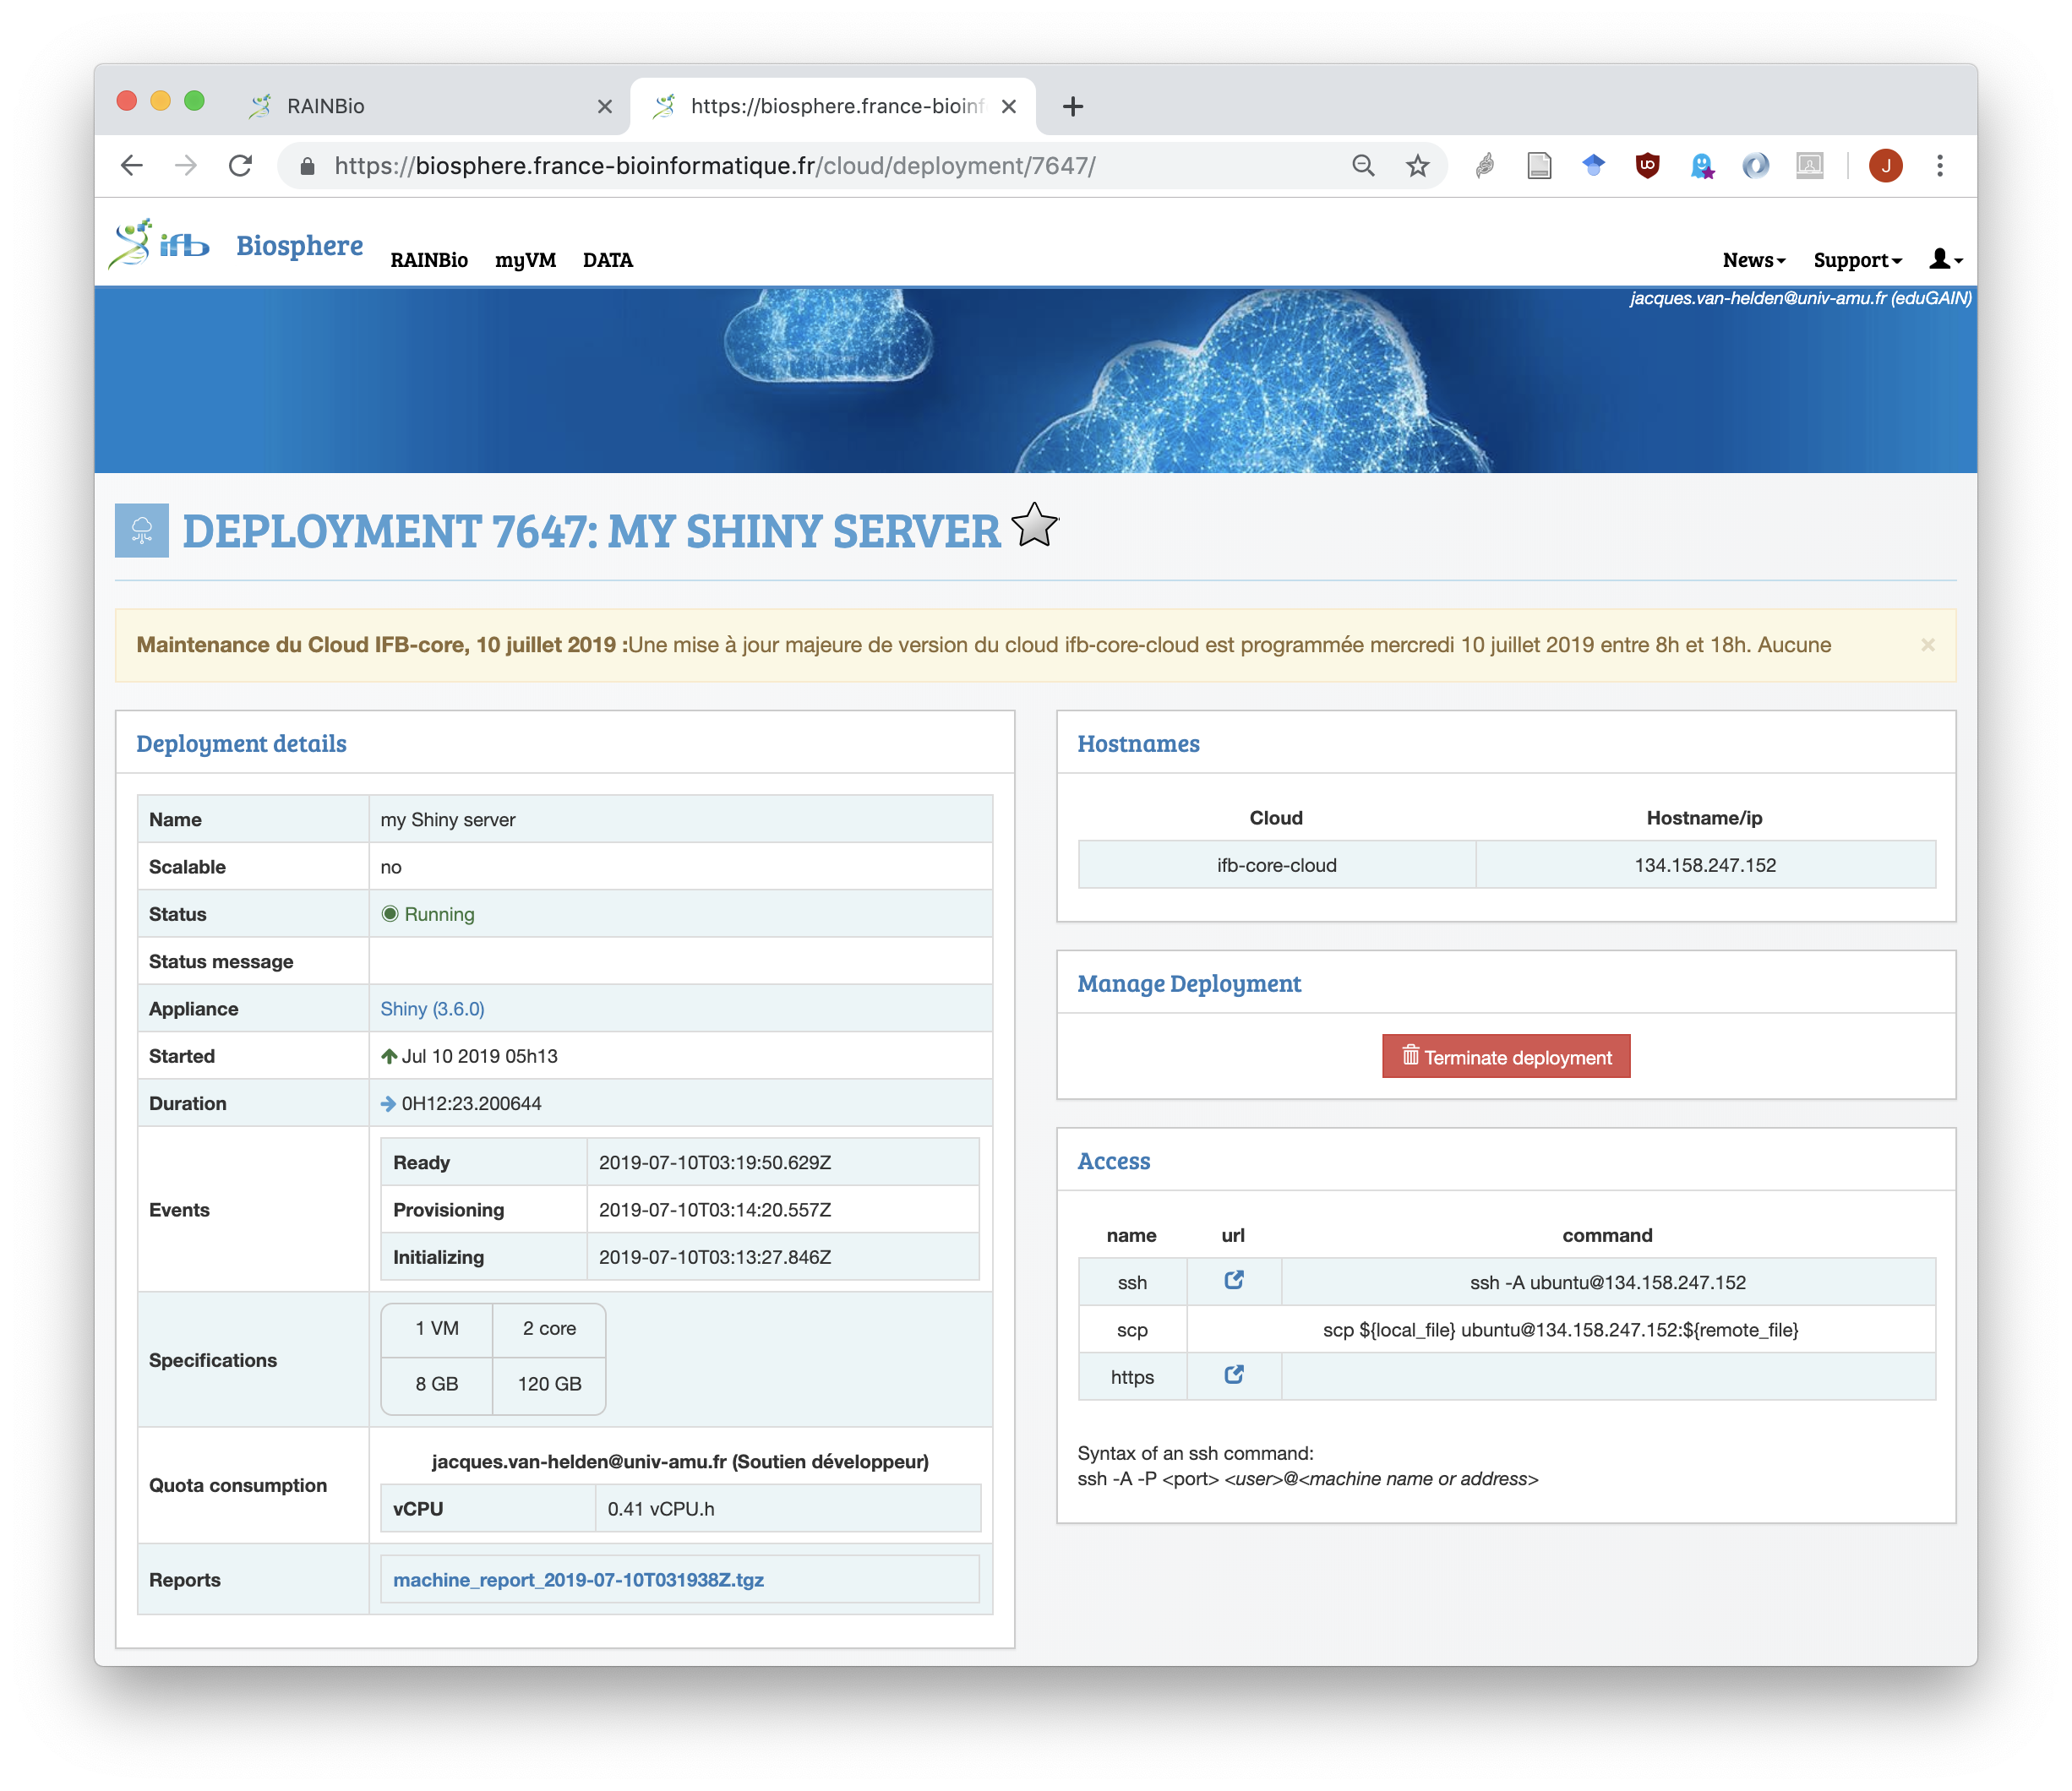
Monitoring your deployed VM
In the list of deployments, click on the ID of your Shiny VM.
This displays the detailed information about this VM.
On the left side, find the instructions to login via a terminal (ssh) or via a Web server (https).

Slide 128
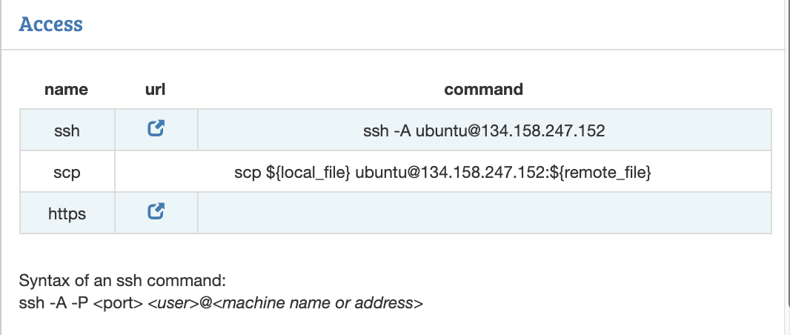
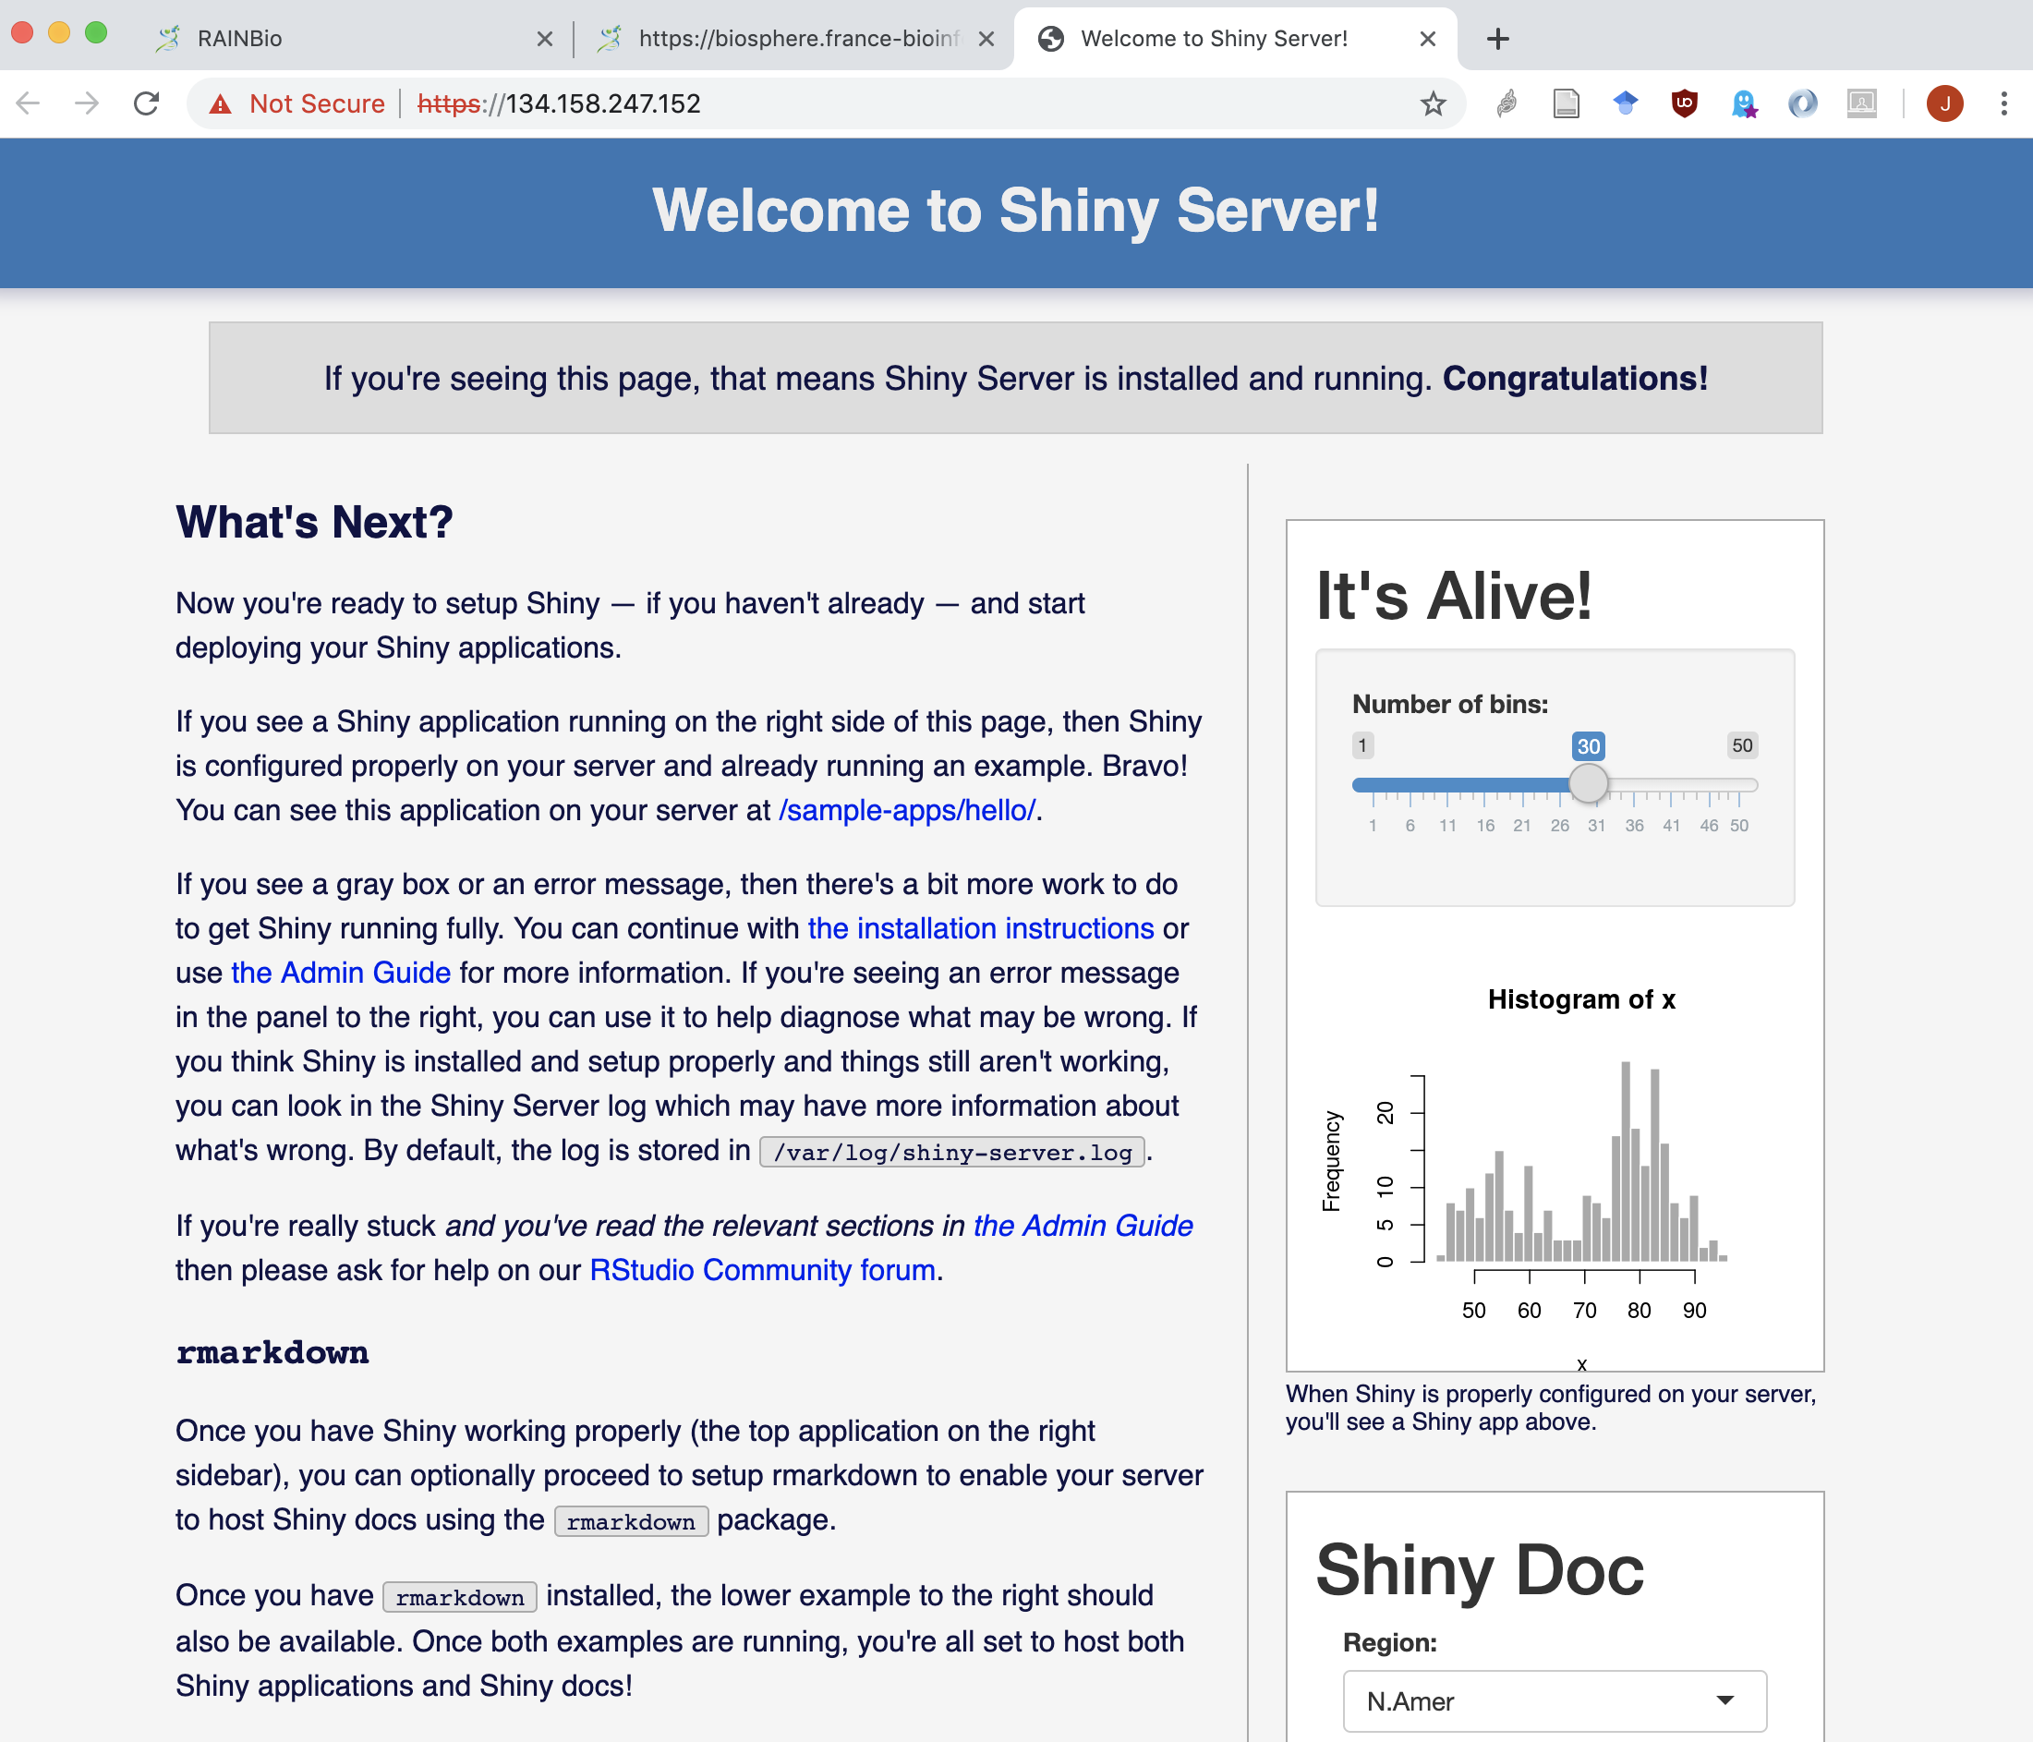

Accessing your Shiny Web server

Slide 129
Installing and deploying your application on your Shiny VM
Install your applications in subfolders of
/ifb/shinyapps
For example
/ifb/shinyapps/myapp/myapp.R
Note: this folder belongs to root, but you can become root of your VM with
sudo bash
Access your Shiny app by appending the folder name to the URL of your server.

Slide 130
Bring Your Own Script

Slide 131




Bring Your Own Script
From a personal script, start to develop your Shiny app …

